Slide 1
Making the Most from iBooks
presented by Amy Atwell
RWA National Conference, July 2017
Notes:
Opening Poll to Establish Audience Base: (show of hands)
• How many of you are indie published?
• How many of you distribute your books directly on the Amazon KDP dashboard?
• How many of you have your books available on iBooks?
• How many of you distribute via Smashwords? Via Draft2Digital?
• How many of you have your own iTunes Connect publisher dashboard?

Slide 2
What We’ll Cover:
Apple as an eBook retailer
iBooks App and Apple devices
How to get your book on iBooks
iTunes Producer software for uploading content
iTunes Connect publisher dashboards
Questions!

Slide 3
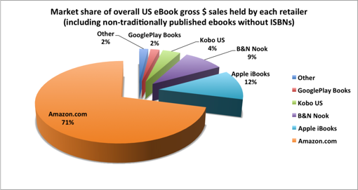
Apple as an eBook Retailer
iBooks retails ebooks in 51 countries
iBooks is considered the #2 retailer of US ebooks (in gross $ sales)
Author Earnings survey graphic, Oct. 2015, is licensed under a Creative Commons Attribution-NonCommercial-ShareAlike 4.0 International License.
Notes:
• Author Earnings survey below (from Oct. 2015) lists iBooks as representing 12% of US eBook gross $ sales, second to Amazon.
• Consider: of the 71% market share granted Amazon, how many of those authors sell exclusively on Amazon? iBooks is definitely #2 in the market share, but it can represent much more than 12% of an author's income.

Slide 4
iBooks App and Apple Devices
The iBooks app is the default bookstore and reading app on all iPhones, iPads and all Mac computers
In Q4 2016, Apple sold:
over 40 million iPhones
over 9 million iPads
over 4.5 million Mac computers
= 50+ million new devices that run iBooks in 3 months
Notes:
• (Second point above: by comparison, found a report that Amazon sold 5.2 mil Kindle tablets during Q4 2015 – at a $50 price point)
• Worldwide, Apple has sold over 1 billion reading devices, much more than all of their competitors.
• iBooks fully supports ePub 3 format, which allows for multi-functional books containing embedded audio and video.

Slide 5
How Do You Get to iBooks?
Consider: Time vs Money vs Control
Distribute via an “aggregator” such as:
Create a publisher dashboard on iTunes Connect
Notes:
• Aggregators are far simpler, but give you less direct control.
• Going direct in itself doesn't give an immediate sales advantage. For authors who want more direct control of their distribution, pricing and contact with iBooks, it can mean an increase in earnings.
• You must use a Mac computer to upload new books or updates to the "asset" files (book epub file, cover jpg file) and certain metadata fields, or hire someone to upload for you

Slide 6
iBooks: Not Scary, Just Different
iBooks App is “closed” store environment not website
iBooks accepts only valid, compliant ePub files
iBooks identifies author, publisher, and the seller
The content provider is the seller, iBooks keeps a commission
Apple does not issue 1099-Misc for “royalties”
Notes:
• iBooks is a "closed" environment. Meaning that their store isn't housed on a public website.
• Slides 7 & 8 don’t focus on the arrow just yet!
Show difference of a web page mimicking iBooks vs true iBooks screenshot.
• When you're using iBooks to read an ebook, if the reader clicks a link to another of your books, you want to keep them in the iBooks environment whenever possible.
Links that open the browser on an iPad can lead to a page that looks like iBooks, but then the reader has to click again to re-enter the store.
Return to Slide 6
• iBooks only accepts a valid, Apple-compliant epub file for the book.
• Pagina ePub Checker https://www.pagina.gmbh/produkte/epub-checker/
http://validator.idpf.org online ePub Validator
• iBooks will list the legal name associated with your account as The Seller. To keep your legal name private, you may use a DBA or list your account as your LLC if you have one. Note: if you create account with legal name, there are ways to apply for and have The Seller name changed to your publishing company name or pseudonym.
• iBooks treats indie authors as true publisher entities. Book sale proceeds are earned by you and iBooks deducts their commission, rather than paying you a royalty. They do not issue 1099s to publishers. Some metadata will be harder to update.

Slide 7
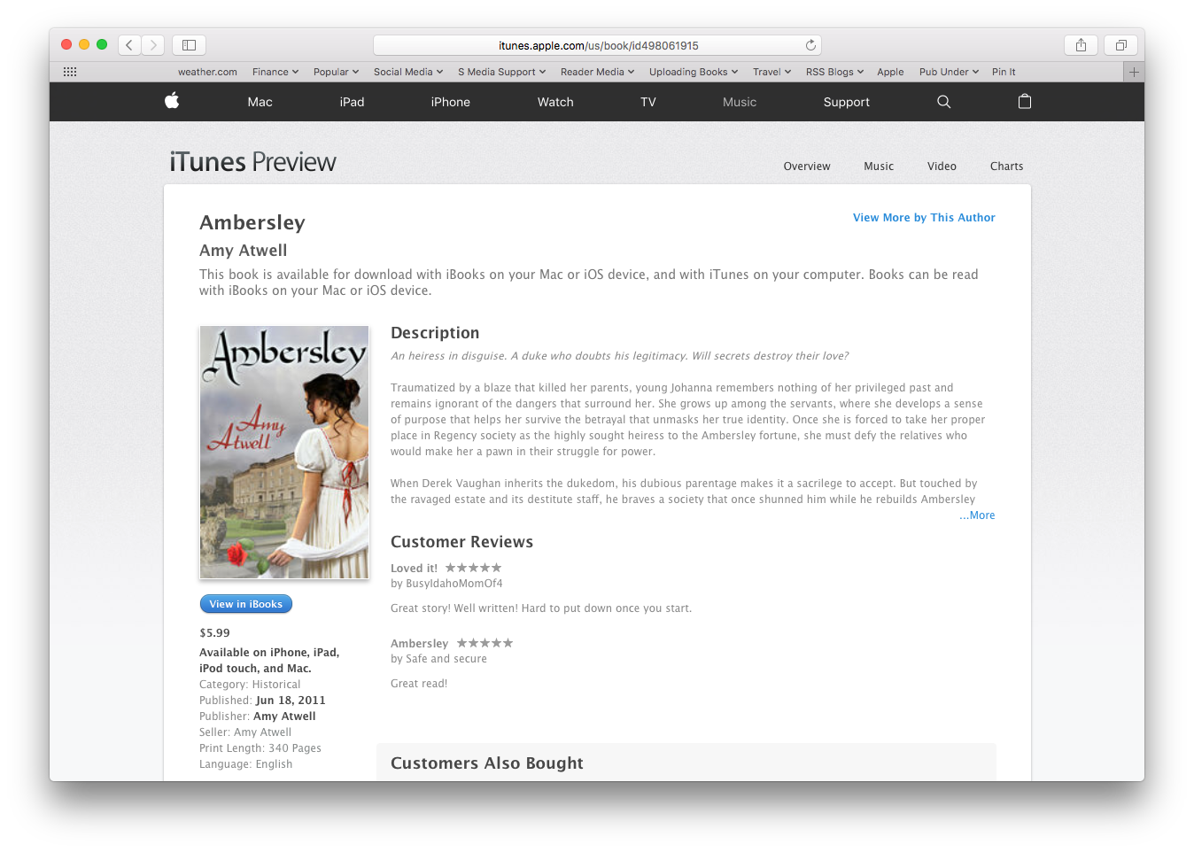
iBooks on the Internet

Slide 8
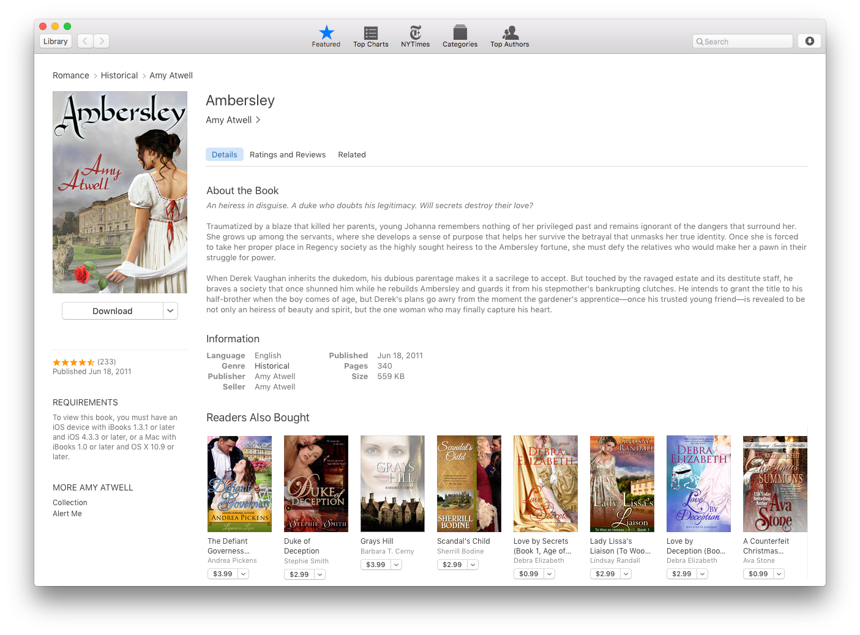
iBooks Store

Slide 9
Creating an iTunes Connect Account
Starts with an Apple ID https://appleid.apple.com
You have one if you own an iPhone, iPad or use iTunes, iCloud
Email addy, real name, address, credit card information
Apply: https://itunes.com/sellyourbook
Be sure to choose PAID account and not FREE
Enter your Legal Entity Name
This becomes The Seller field on iBooks
Start with your real name or LLC - can be changed later
Must match your tax and banking information
Approval takes only a few days
Notes:
• Creating an iTunes Connect publisher account is a multi-step process that many find confusing. (it's actually very similar to other retailers, just less familiar)
Be sure to submit legal name and follow up with matching tax and banking info. If identity information doesn’t match,

Slide 10
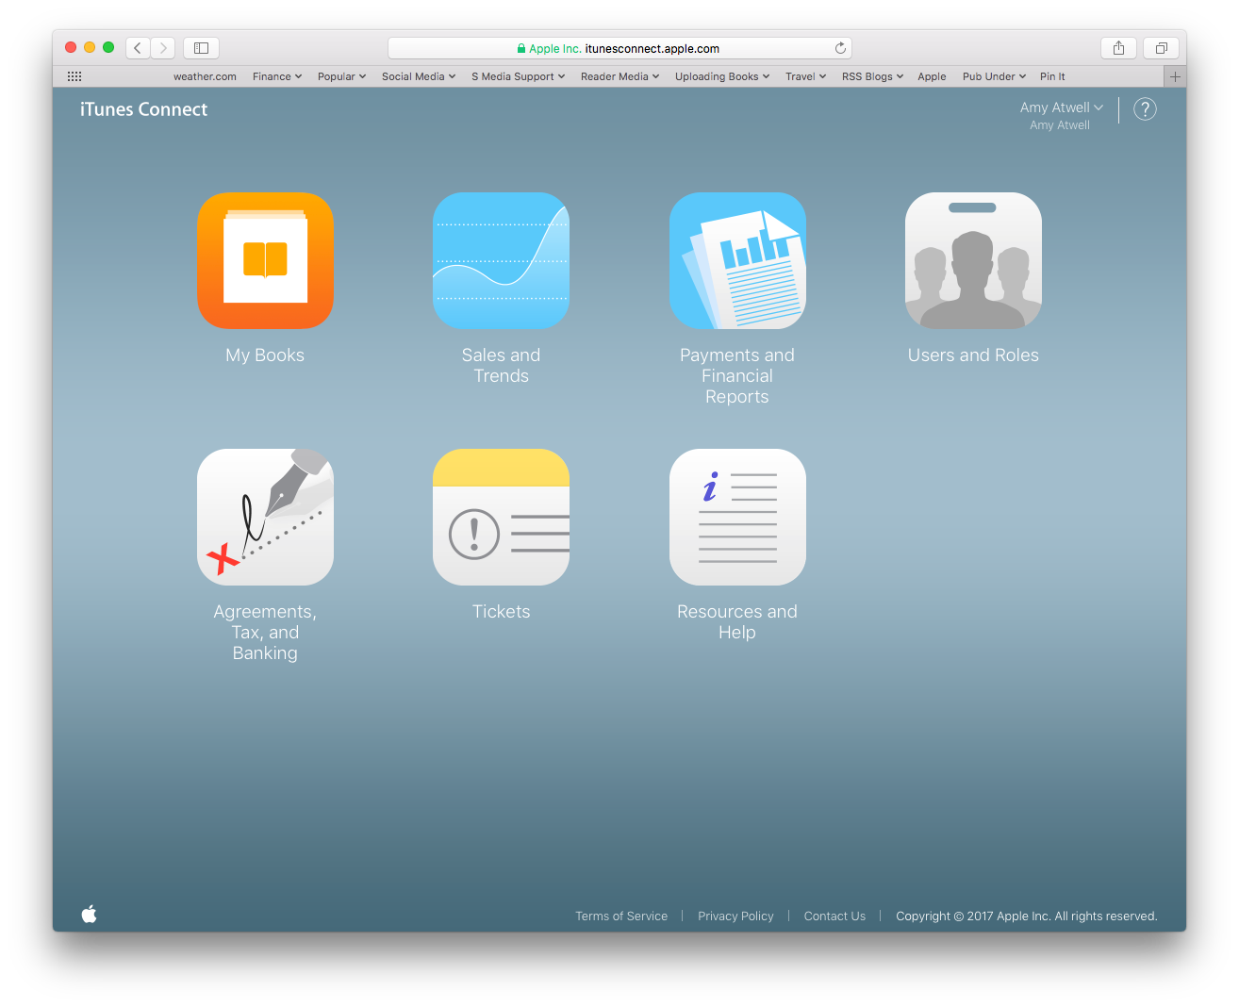
When your dashboard is approved, you must request your contract and fill in your tax and banking info before you can upload books.
Notes:
• 10 New accounts are approved by Apple and tax information verified. Account setup typically takes a business week.

Slide 11
Uploading and Managing
iTunes Producer
Mac only
~ ePub file
~ Cover .jpg
~ Series info
iTunes Connect
Any Computer
~ apply for account
~ update description
~ update price/availability
~ monitor sales and pmts
Notes:
• You must own a Mac computer to upload new books or updates to the "asset" files (book epub file, cover jpg file) and certain metadata fields, or hire someone to upload for you
• Once uploaded, you can manage your book pricing and most metadata via the iTunes Connect dashboard, which you can access from any computer or tablet (there's even an app for iPads)
• iBooks has real human beings who review the content and may ticket your book for a host of reasons. The pro to this is there's not a lot of "garbage" content on iBooks, which you often find on other retailers. Oh, and the people are smart & friendly.
• Unlike other retailers, you can have two publisher dashboards at iBooks.

Slide 12
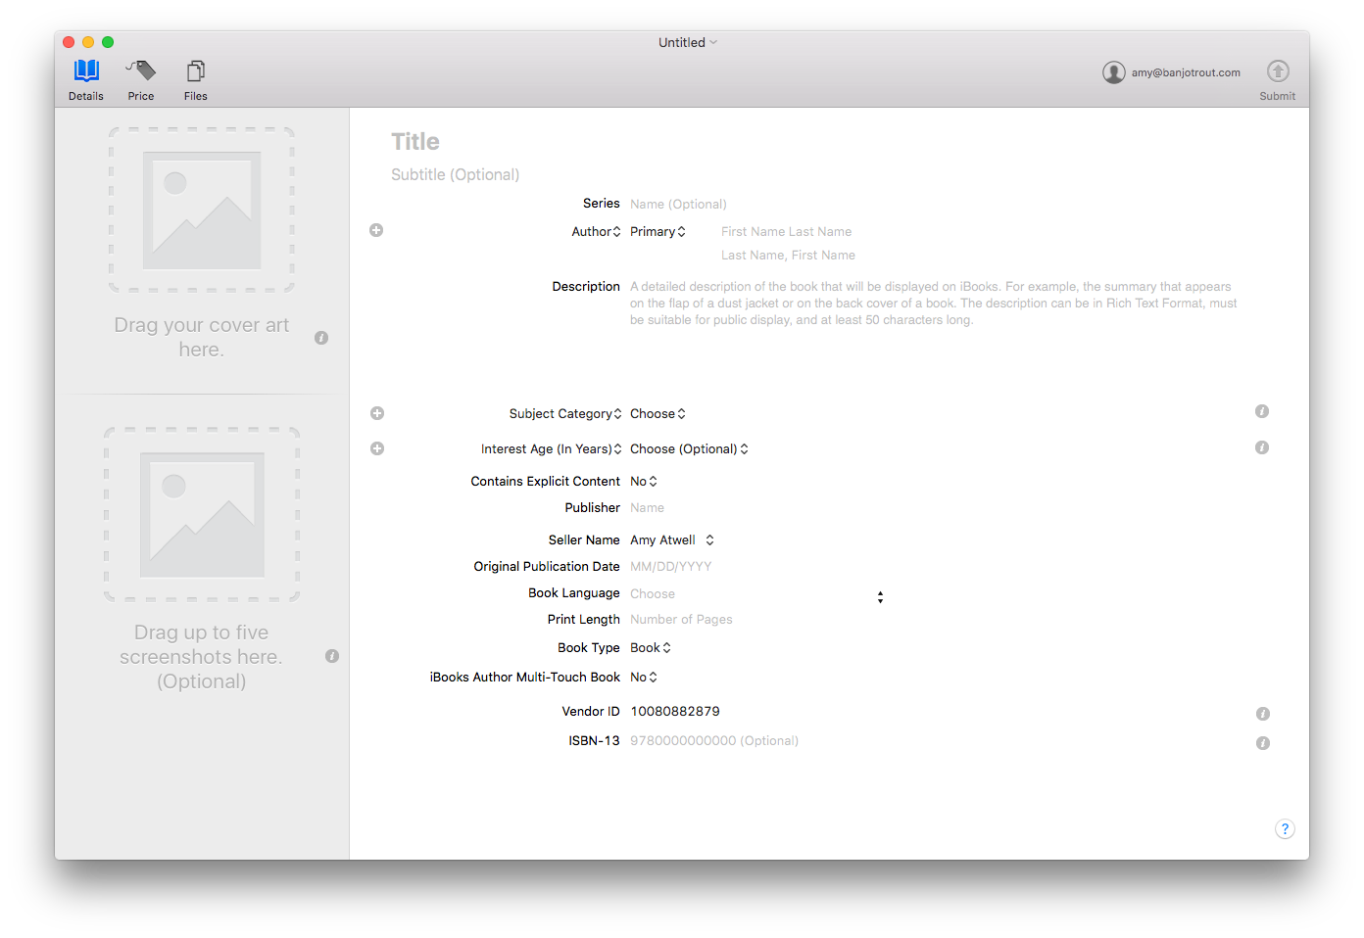
ISBN Tips:
~ Must be included with original upload if you plan to use one.
~ Still recommended by iBooks, but not required.
~ Can never be edited. NEVER.
Notes:
• 12-13 Show the iTunes Producer metadata page, discuss ISBN consideration

Slide 13
Switch to your own dashboard from Smashwords or D2D
If you change distribution, you will lose all ratings and reviews.
Notes:
• Changing distribution from SMASH or D2D to your own publisher account will result in those books losing any ranking or reviews. Must use new ISBN.

Slide 14
Pros of Going Direct
You earn 70% of list price on ALL price points
You can upload asset-less pre-orders up to 364 days in advance of release date
Create a specific ePub file with iBooks and iTunes links
iBooks accepts ePub2 and ePub3 file formats, Multi-Touch books, embedded audio and video
iBooks gives you 250 Promotion Codes per book; these can be used as soon as the book file is uploaded, even during pre-order
Notes:
• Apple retains 30% commission, so you get 70% of the proceeds of ALL book sales at ALL price points. This is bonus income for books priced 0.99-$1.99, or over $9.99. Many authors find success with higher price points.
• You can upload asset-less pre-orders up to one year in advance of release date. (also available via D2D, Pronoun? SW?
• Pre-orders count when order is placed and count again on the release date. Two opportunities to build visibility, and you get the advantage of the release day bump in tallied sales.
• You can upload an Apple-specific epub with links to your other books, or perhaps to a playlist associated with your book. Use affiliate links to increase earnings.
• iBooks accepts ePub2 and ePub3 file formats and can support Multi-Touch books, embedded audio, video; other retailers still want ePub2 format.
• iBooks gives you 250 Promotion Codes per book to give away free copies of your books.
Go to Slide 15
You may start distributing promo codes as soon as the book file has been delivered. These codes are unique (can only be used once) and expire four weeks after you generate them.

Slide 15
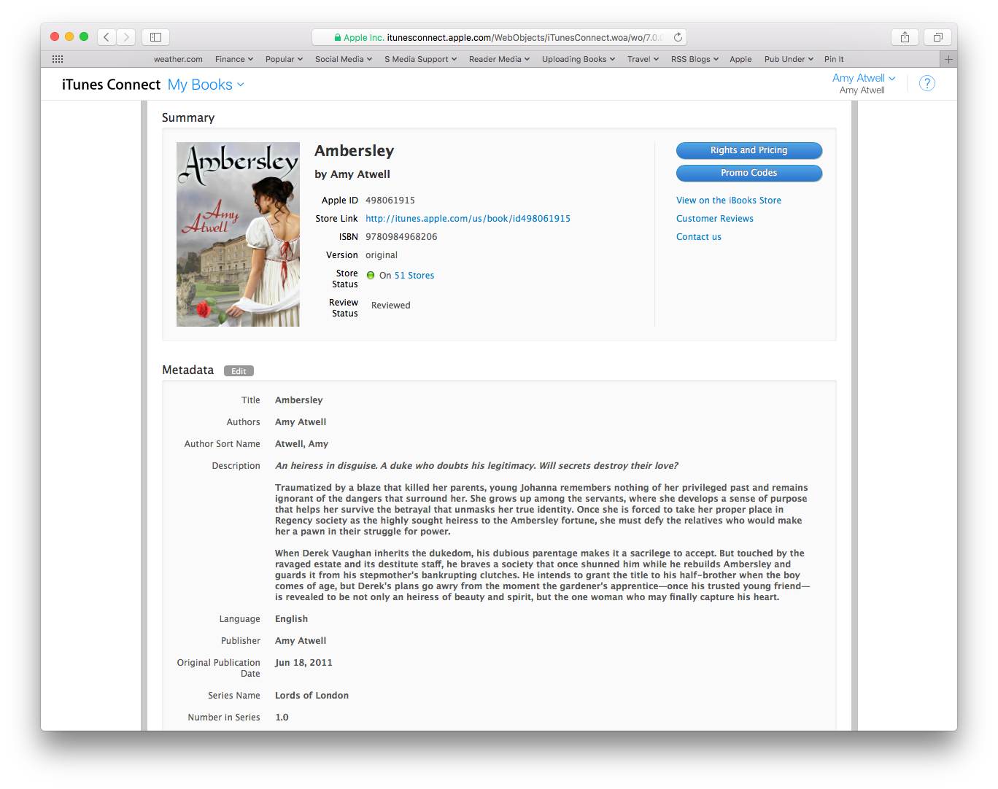
250 Promo Codes
Notes:
• Available on your iTC dashboard
• iBooks gives you 250 Promotion Codes per book to give away free copies of your books. You may start distributing promo codes as soon as the book file has been delivered. Readers can get an early copy of your book and leave ratings and reviews even if book is still in preorder status.
• These codes are unique (can only be used once) and expire four weeks after you generate them.

Slide 16
See all reviews from all countries
Notes:
• You can view all reviews of your books from all countries on your iTC dashboard.

Slide 17
Contact Us offers tons of info and ways to communicate with iBooks
~ Series Linking
~ Change Seller Name
Notes:
Easy to apply for series recognition and linking. This is a manual process, and aggregators may or may not get your books properly linked.
Go to Slide 18 to show an example of the Contact Us Page

Slide 18
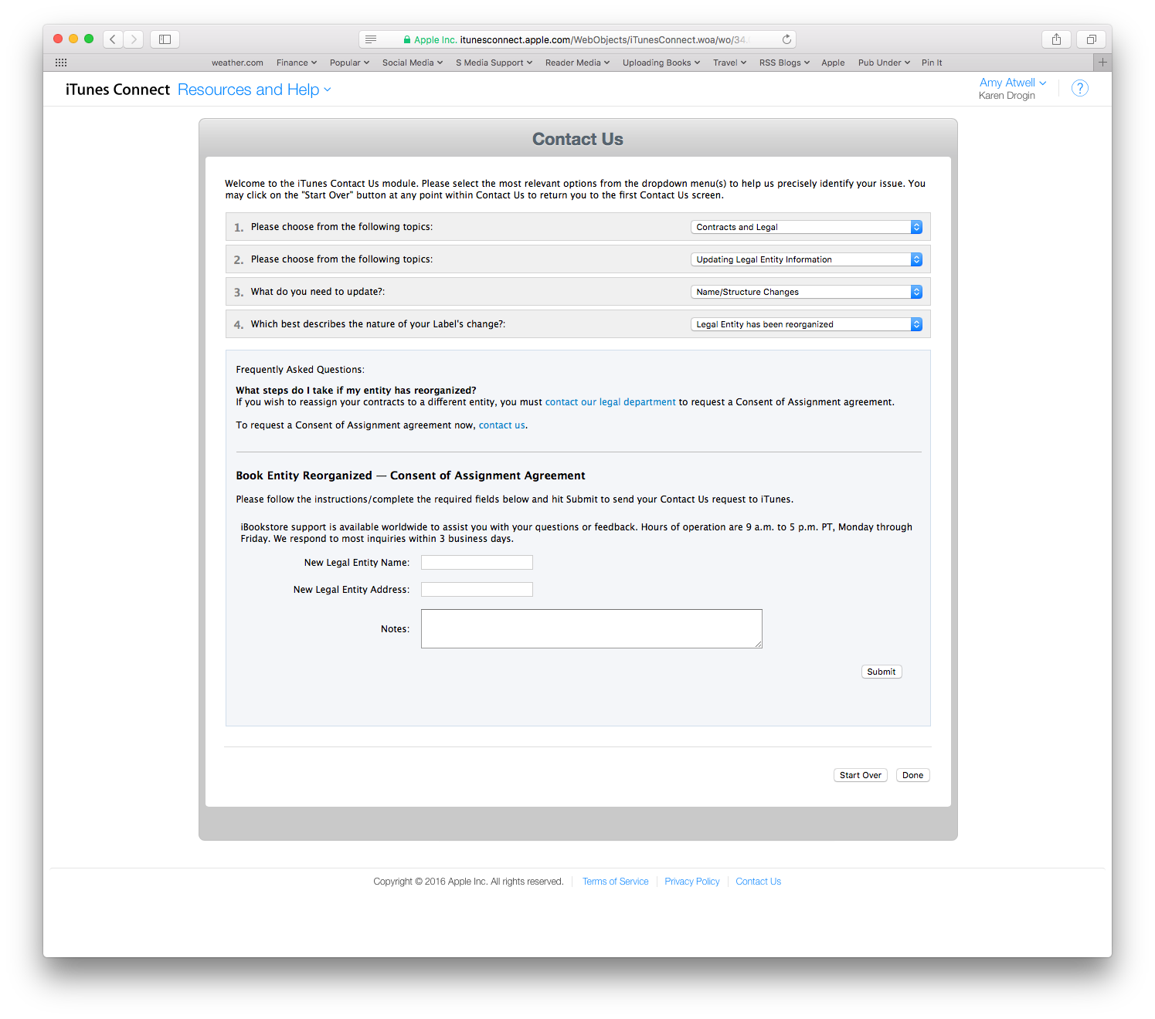

Slide 19
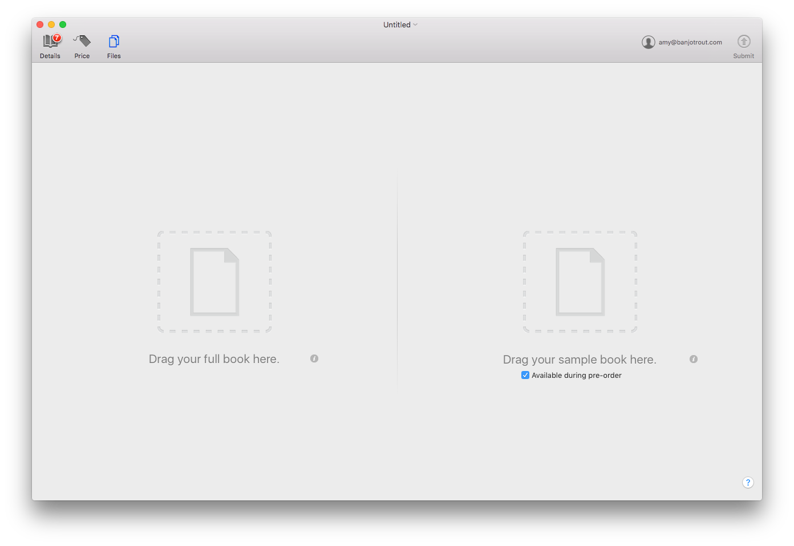
No placeholder file, but you can upload a custom sample for preorder
Sample on RIGHT
Notes:
You can upload a Custom Sample—great for pre-orders and collections/anthologies
Go to Slide 20 to show example

Slide 20
What it looks like to the reader…
Notes:
View from within iBooks app of reading the end of the sample. Instead of ending at end of a chapter, you can include standard end matter. iBooks adds the buy button and cover at the end.

Slide 21
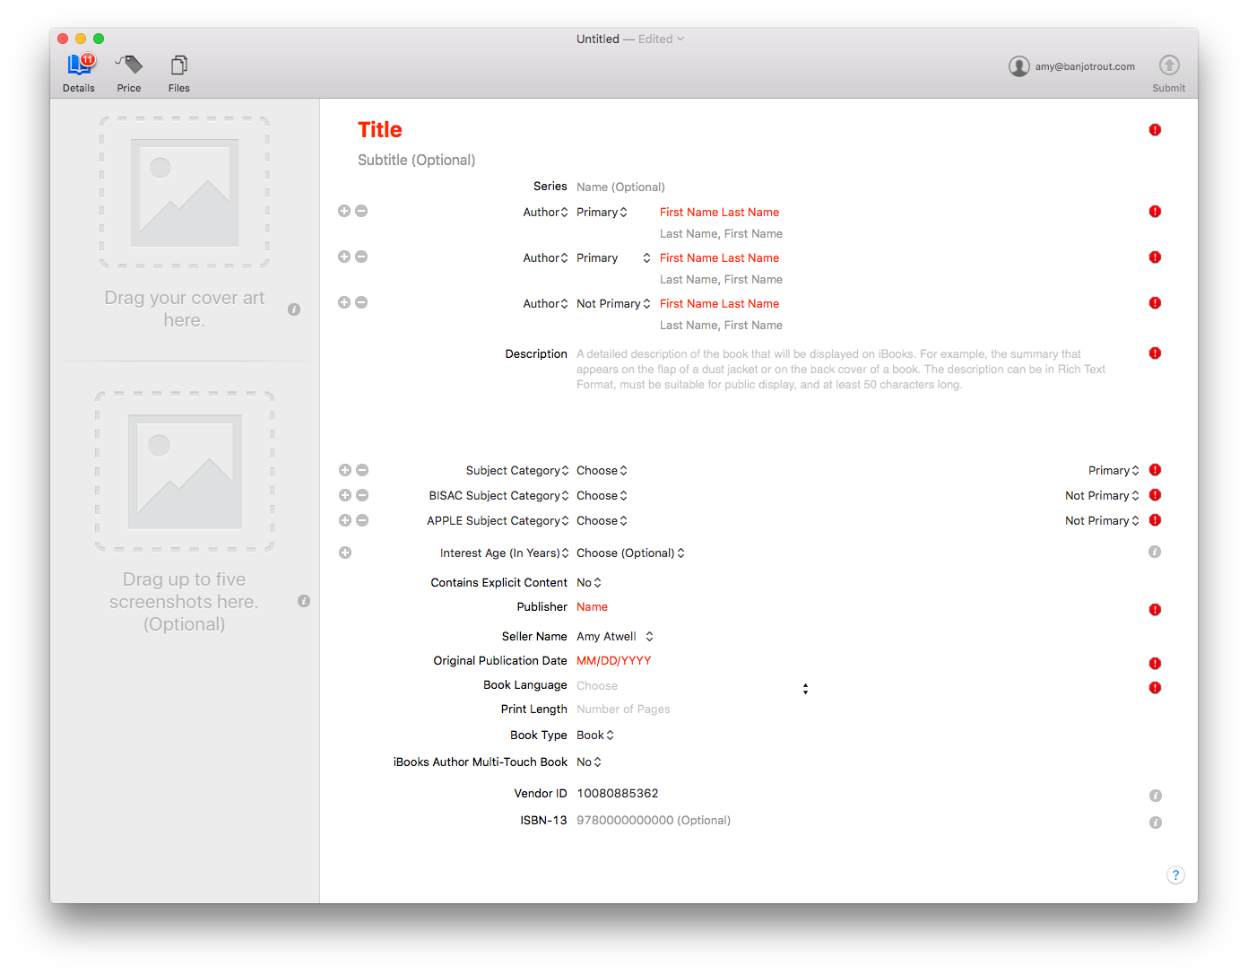
Anthology Authors (primary)
Notes:
Also for anthologies, iBooks recognizes up to 10 Primary Authors, meaning that anthology can be linked to up to 10 author searches in iBooks.

Slide 22
Choose Category for iBooks (primary)
Notes:
• Can choose specific Apple categories to ensure your book is sorted to the right "department" in iBooks
Be sure to designate a PRIMARY designation

Slide 23
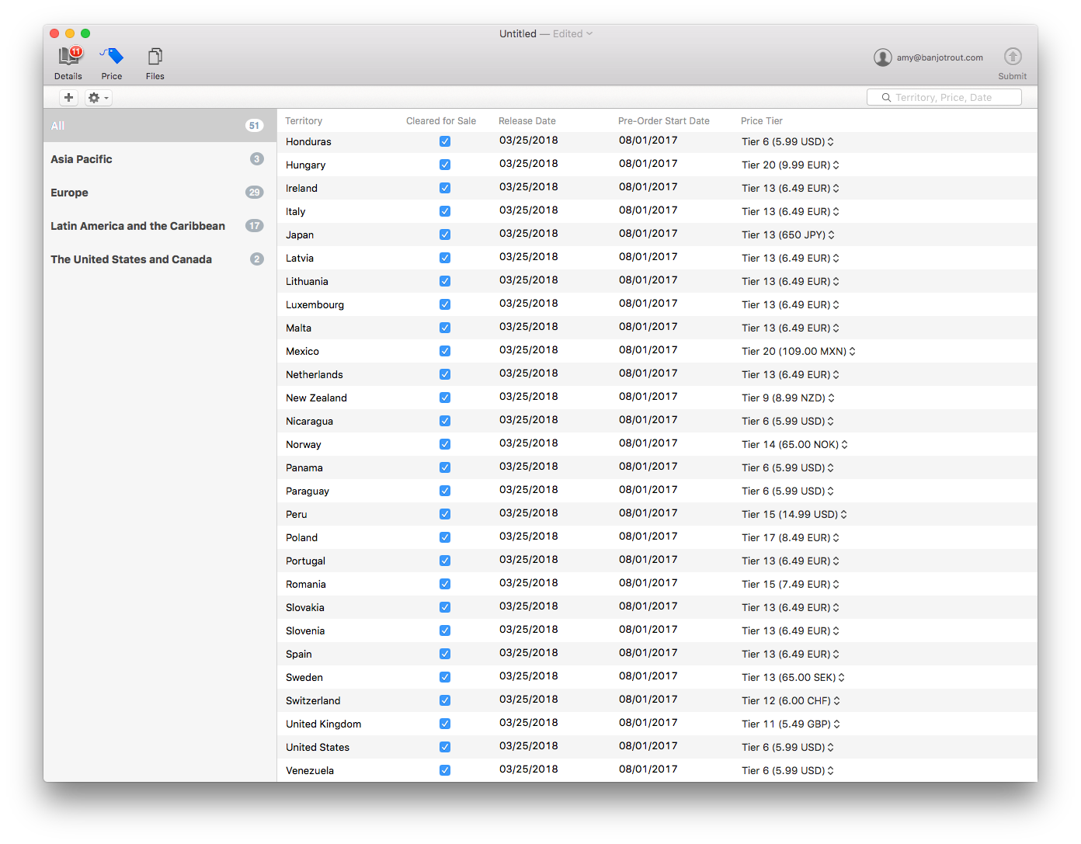
Setting Price Initially in iTunes Producer
Notes:
Easy to set foreign currency pricing using Price Tiers
This is iTunes Producer, and you can set a future release date plus a future pre-order goes live date
You can adjust each territory individually. Tiers always end in either .99 or .49.
Tiers are not an accurate currency conversion. They represent a comparable price in that currency to what you’ve set in USD.
Go to slide 24 to show how to manage pricing in iTunes Connect

Slide 24
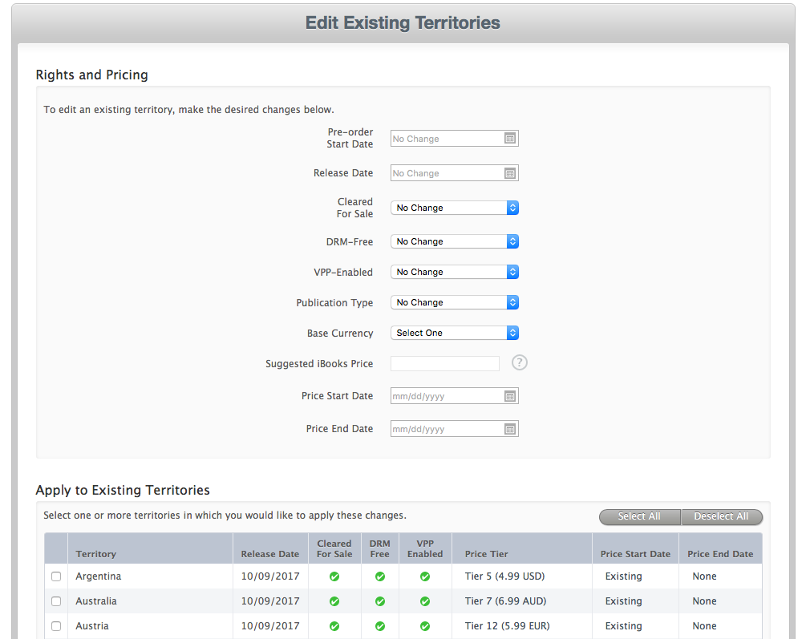
Manage and Update on iTunes Connect
Notes:
Once a book is uploaded to your iTunes Connect dashboard, you can control pricing and availability from there. Again, you can adjust all territories or individual territories.

Slide 25
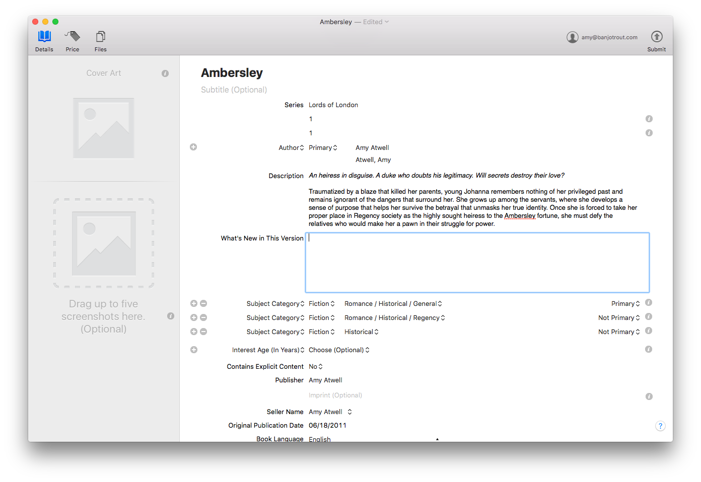
What’s Versioning?
Add info here of what’s new. New excerpt? New bonus scene?
Notes:
iBooks supports "versioning", which means that when you upload an updated version of your ebook file, buyers who've already downloaded your book will get an automated alert that they can update the book content.
If you use Vellum and make an iBooks ePub and use a Version Number in your file, you may get an error on uploading where iTunes Producer will expect you to fill in the New Version info.
Not so important if you’ve fixed a few typos, but if you’ve added an excerpt to a new upcoming book, you can add that info.

Slide 26
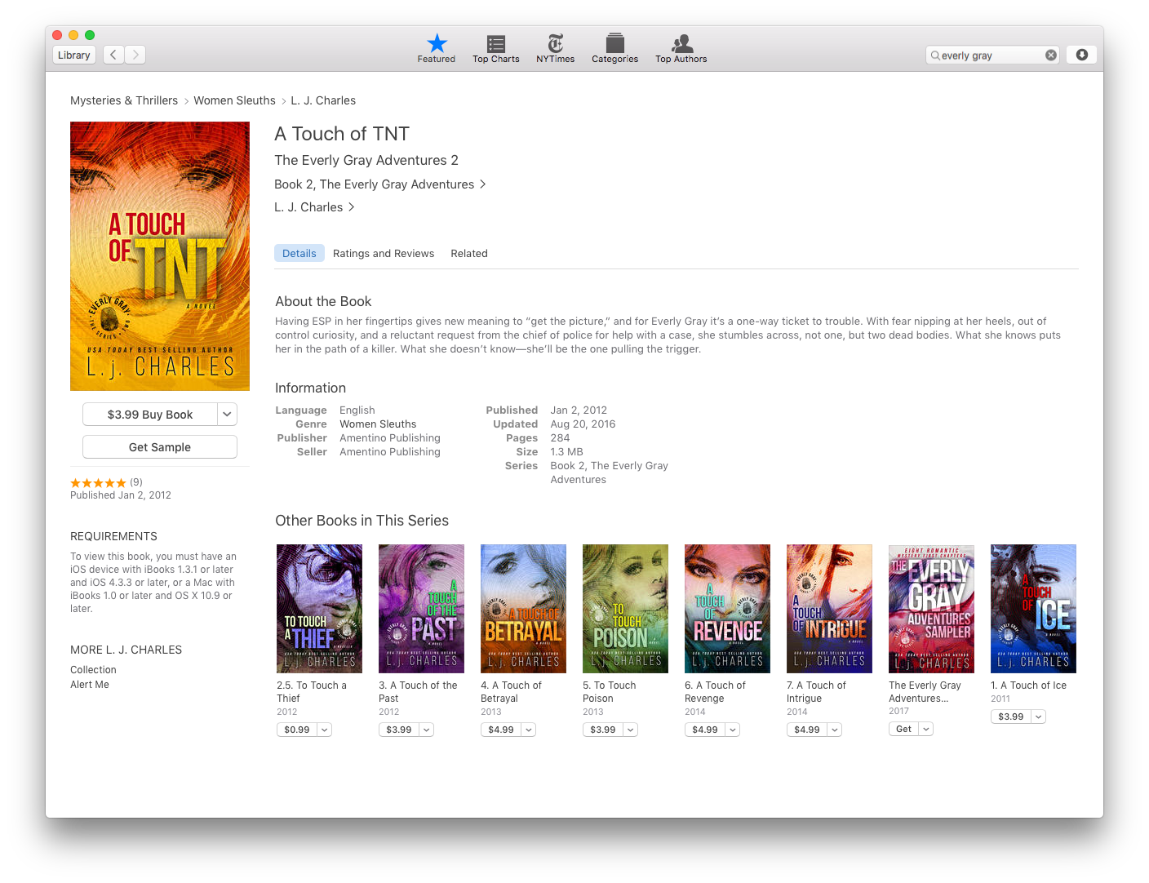
How Linking a Series Works for You
Notes:
26-28 Slides to show series linking in action
You can request via your iTunes Connect dashboard Contact Us page.
If distributing via an aggregator, be sure that you include Series info and that the Series Name is EXACTLY the same for each book in the series and the books are numbered sequentially.
It may be possible to link self-published books with traditional publisher books of the same series. One factor is that the books must all be offered in all of the same territories.

Slide 27
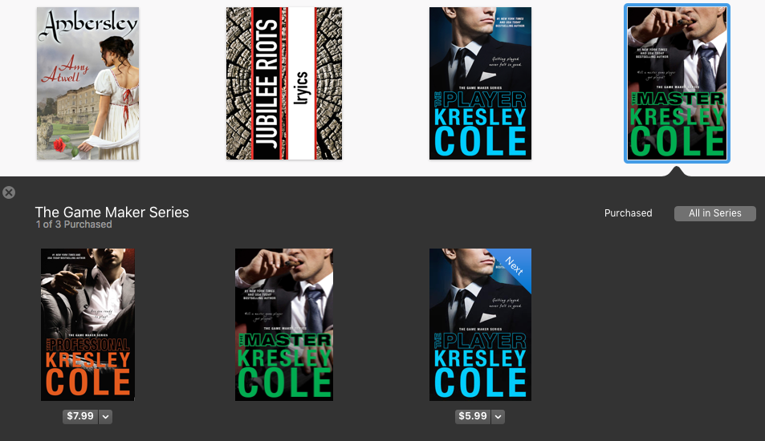
On iBooks App Library View

Slide 28
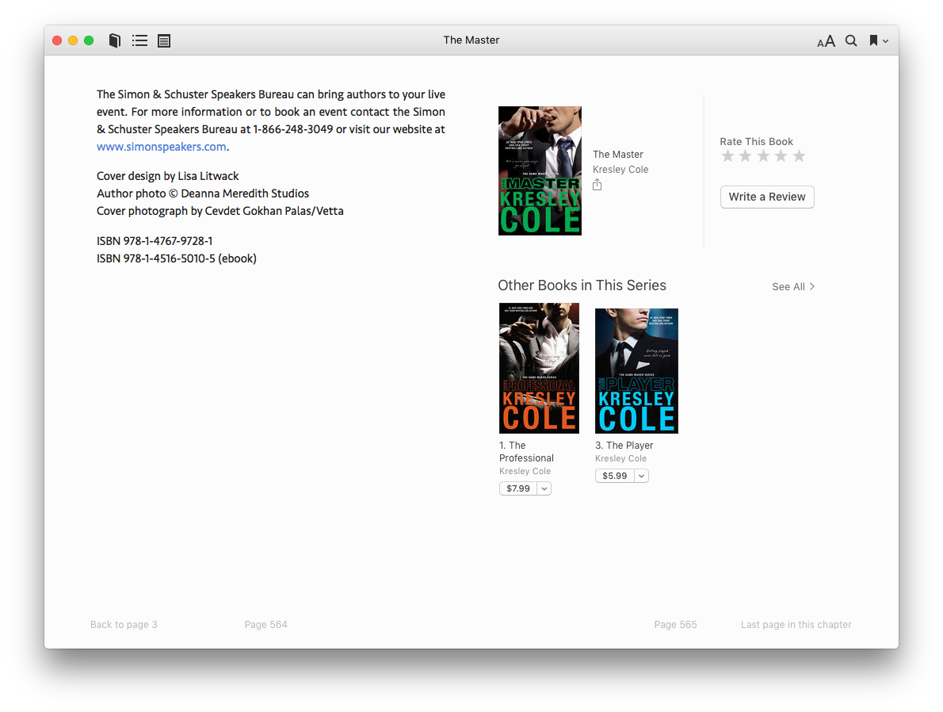
At the end of the book in iBooks

Slide 29
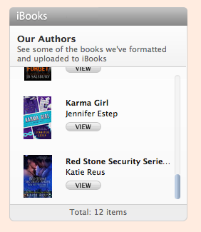
Tools to Gain Advantage on iBooks
iTunes Link Maker - links and more https://linkmaker.itunes.apple.com/en-us
Affiliate Program
Banners
Widgets
7% commission:
iBooks
Music
TV & Movies
Apps
Notes:
877-206-2092
contact our support team to learn more about tools and resources to help them market their books (support can walk them through this over the phone, if they want). We also have a dedicated section in our FAQs around marketing:
http://itunespartner.apple.com/en/books/faq/Market%20Your%20Book_General%20Information

Slide 30
Top 10 Reasons
your book fails to upload
or gets ticketed by iBooks
Notes:
1. Your epub file is not valid.
2. Your epub file is valid, but uses certain HTML syntax that's not supported by iBooks.
3. Your ePub3 file is valid, but you didn't include versioning information (occurs if you use Vellum to create an iBooks epub)
4. An image embedded inside the ePub file is too large.
5. You mention or have links to other retailer within the epub file.
6. You use improper iBooks branding. (list the most common errors inside epubs)
7. Your ePub file has no NCX navigation, or has only a Start tag.
8. You listed non-title information in the title field of your metadata: Title of Book: a Contemporary Romantic Comedy
9. You mention a special price or discount in your book description field.
10. You've selected an incorrect primary category for your book. Applies to Erotic Romance but can affect other books as well

Slide 31
Questions???

Slide 32
amy.atwell@authorems.com

Slide 33
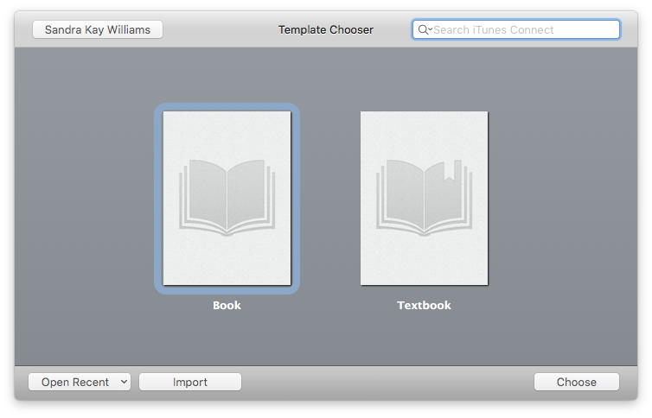
This pulls information from iTunes Connect so you can view on your computer
Updating a Book
This opens saved files on your computer
Notes:
This is just an extra slide, in case someone asks this question.

