Slide 1
Aversion to Conversion:
Why You Should Actively Manage Foreign Currency Pricing
$ £ €
presented by Amy Atwell, Author E.M.S.
NINC Conference, September 2018
http://www.authorems.com/author-services/downloads/
Notes:
Opening Poll to Establish Audience Base: (show of hands)
• How many of you are indie published?
• How many of you distribute your books directly on KDP, KWL, BN Press, Apple Books?
• How many of you distribute via Smashwords? Via Draft2Digital?
• How many of you are here for the “bonus content”?

Slide 2
What We’ll Cover:
How retailers convert USD pricing to foreign currencies
Pricing and conversion tools on retailer dashboards
How VAT and GST affects pricing in some countries
How to manually set foreign price points on retailers
Setting foreign exact price points for BookBub promos
Questions!

Slide 3
Terms in Pricing:
List Price: this is the price you list on your pricing dashboard.
Converted Price: this is the price the retailer automatically converts and uses in various foreign currencies. If you set a single USD price, they will set converted prices in other currencies.
Actual Selling Price (ASP): this is the price a customer on an online store sees and what they pay to buy the book.
Value Added Tax (VAT): a tax set in some countries on certain products. Most often, this VAT tax is included in the Actual Selling Price.

Slide 4
When You Set a Single USD Price
KDP, KWL, Google Play, D2D each convert to foreign currencies based on their Terms of Service
Apple suggests a price tier based on USD price; prices end in .99 or .49
Each retailer has their own rules about updating currency conversions, so your foreign pricing can change
Notes:
Amazon: converts at an “exchange rate we determine.” May periodically “update the converted price” to “reflect current exchange rates.”
Apple: suggested tier pricing based on the current exchange rate, plus they factor in whether a territory has a VAT tax, and they add that before suggesting a price.
Kobo: converted prices are based on “recent Bank of Canada exchange rates.”
Google Play: has a currency conversion setting on the Payment Center tab, and you can manually update the rates as often as you like.

Slide 5
VAT Pricing
VAT = Value Added Tax assessed in certain countries
Most of Europe, different for each country
Great Britain
Australia
New Zealand
India
Notes:
• VAT rates vary from country to country. Range from 3% to over 20%.
• Countries that charge VAT on products usually include the VAT in the Actual Selling Price. Google Play gives you the option to include or exclude tax from your price.
• Your royalty is calculate after the VAT is deducted. This is best shown on the KDP dashboard.
• VAT comes into play with BookBub promotional pricing

Slide 6
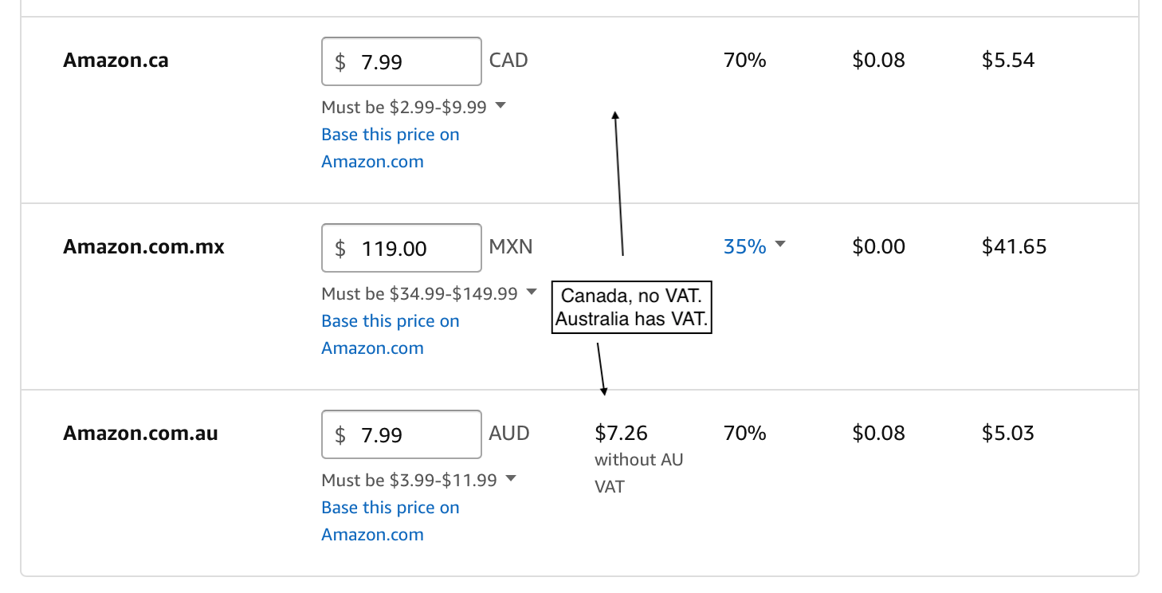
Notes:
The KDP dashboard has great tools to show you what happens with VAT and how it affects your royalties.
KWL dashboard adds an asterisk after a country name if that country has VAT included in the price.

Slide 7
Reasons to Set Your Foreign Prices
All retailers (except Google Play) have in their TOS that you will offer them the same or lower List Price as every other retailer you’re using. Amazon actively price matches.
Certain countries have fixed pricing laws, requiring that the same product be sold at the same price at all retailers.
Each retailer has their own rules for converting and updating, so if you let them convert, you’ll have a hodgepodge of foreign prices.
Amazon, Apple, Google Play allow for different prices per country, but Kobo and D2D only allow one price per currency. Kobo partners want prices that end in .99 or .00
Amazon, Apple, Kobo will include VAT in their ASP. Google Play allows you to include or exclude tax for each price you enter.
It’s just better customer service to have consistent, logical pricing!

Slide 8
Let’s look at some dashboards…
Suggestion: set up all your dashboard login pages on a browser menu.
Notes:
You can then open them in tabs so you have access to each of the ones you need as you change a book’s price. You can compare pricing, view the various tools and then save and submit each one.

Slide 9
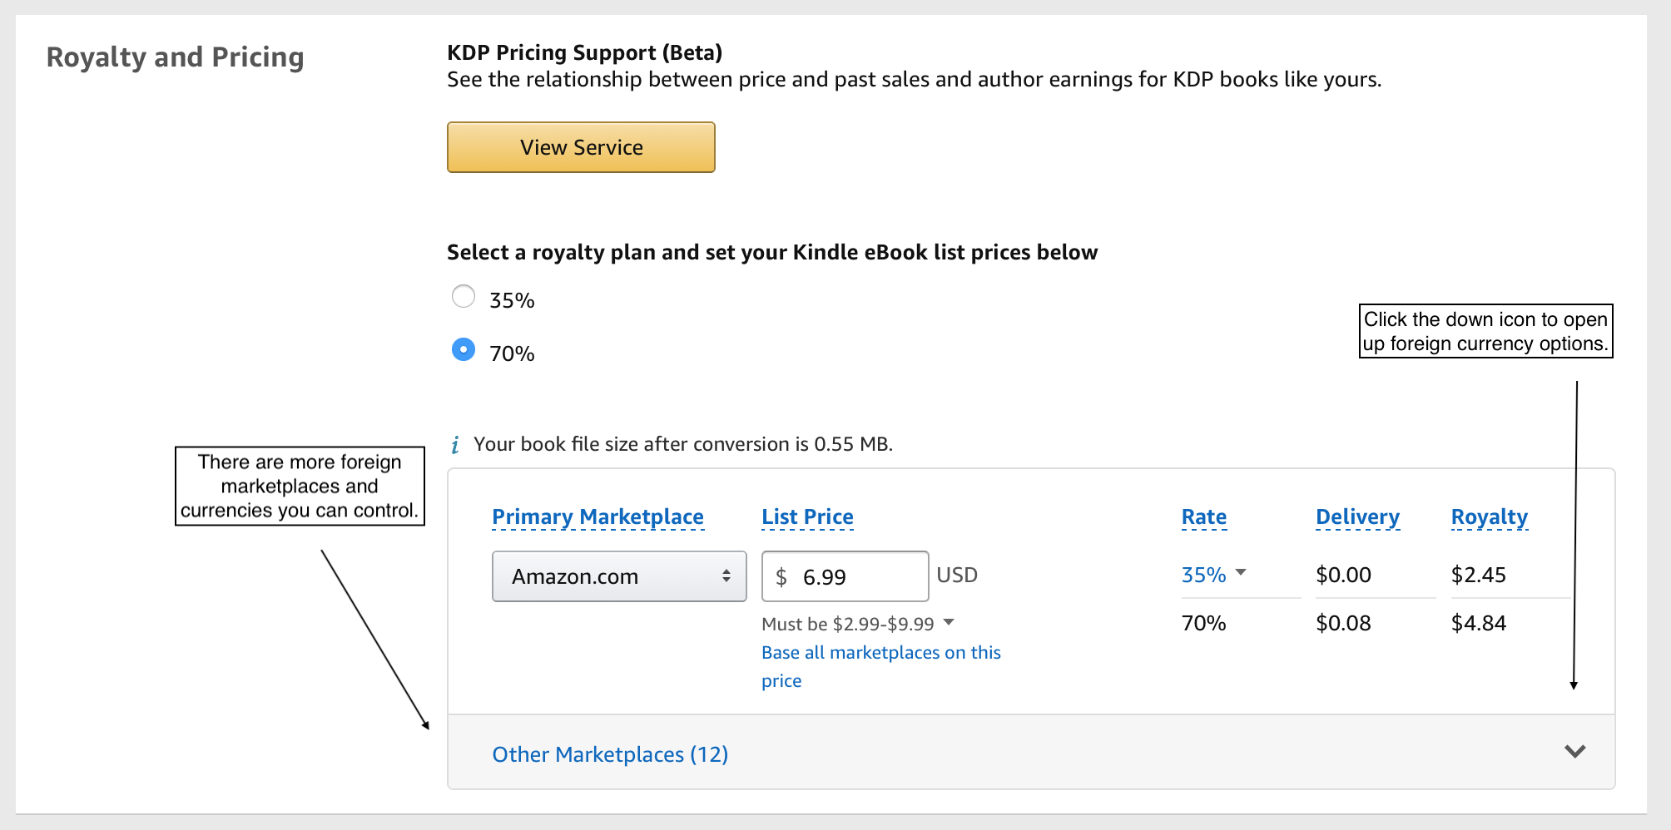
KDP Single USD Price
Notes:
This is what you see on the pricing tab on KDP. It lets you set the one USD price. Unless you click the down icon in the lower right, KDP doesn’t even show you the other marketplaces and the foreign currency pricing.

Slide 10
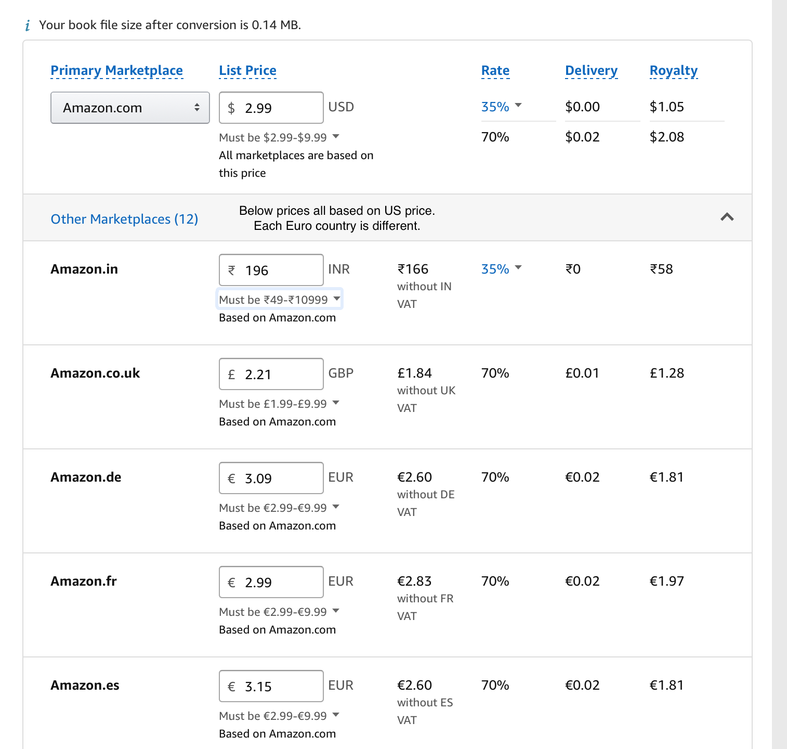
KDP Auto Converted Prices
Notes:
This is what the USD pricing looks like when you open the tab to view Other Marketplaces. Here, Amazon has converted the price on its own. It shows you the ASP and the price without VAT so you can view the royalty calculation.
2.99 USD x .87 for Euro conversion is 2.60. Then each of the Euro countries add VAT:
France 5.5% conversion + VAT doesn’t reach 70% min pricing, so Amazon raised it
Germany 19% and Spain 21% So you now have 3 different selling prices throughout Europe
UK 20% (exchange rate of .615 or so…)

Slide 11
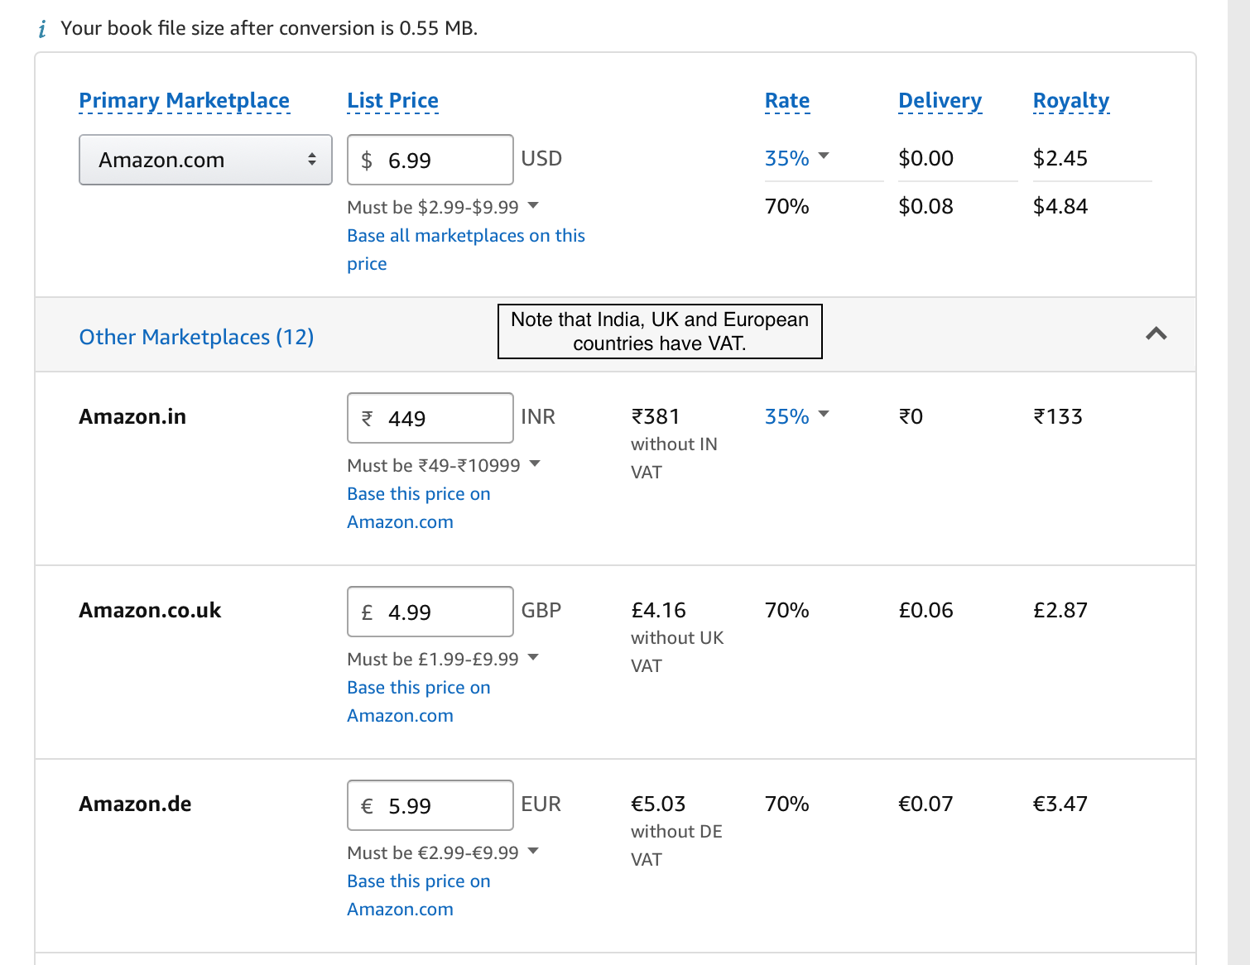
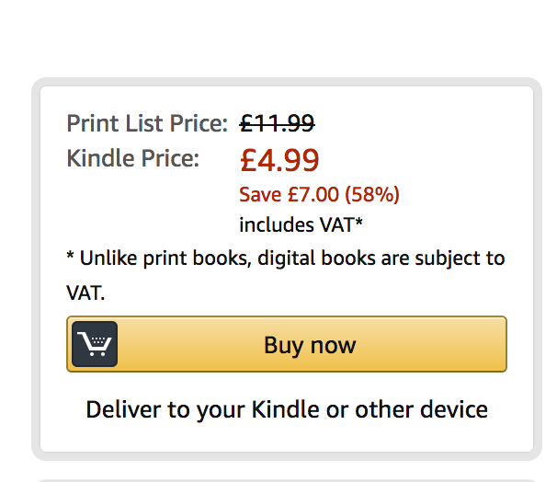
KDP Custom Set Prices
This box shows the ASP on Amazon.co.uk.
Notes:
This starts with a different USD price point, but here I’ve overwritten the Amazon-converted prices with custom prices. This way, I can set all the countries using the Euro to the same ASP. I’ll earn slightly different royalties because the VAT percentages differ from country to country.

Slide 12
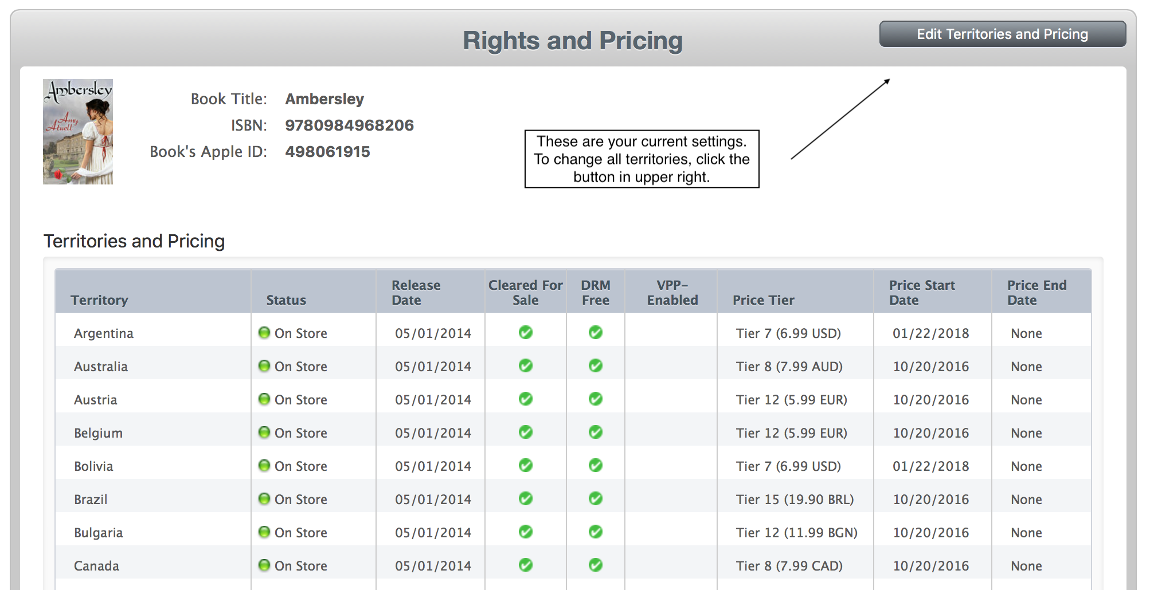
Apple Pricing Page
Notes:
This page shows your current price settings. To edit all countries, click on the gray box in the upper right. Notice that all these prices end in .99.

Slide 13
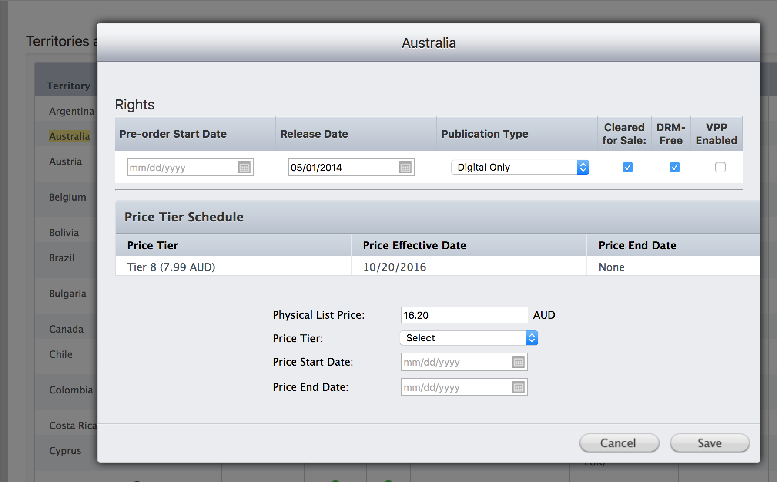
Change a Single Territory Price
Change THIS field, not the one above.
Notes:
From your main Rights and Pricing page, if you click on an individual country name, you can set a new permanent or temporary price.
NOTE: Do not change the Physical List Price field. That price represents what a print copy of the book would sell for. Use the Select button to choose a new Price Tier for the ebook.

Slide 14
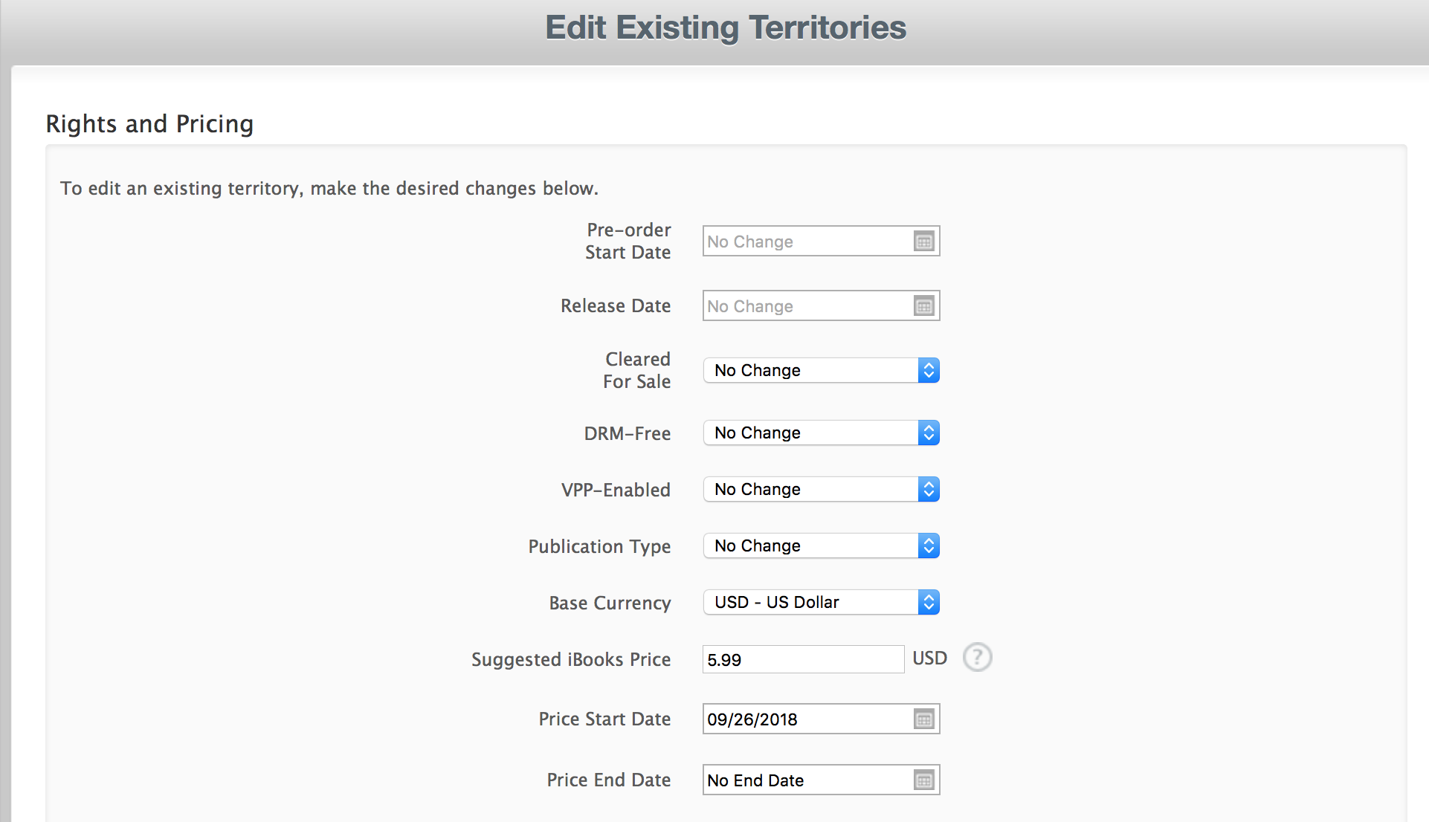
Change Multiple Territory Prices
For a price change, use these 4 fields only
Notes:
From 2 slides ago, click Edit Pricing button in upper right, and you see this at the top of the Edit screen. Only change the fields you need to change. For price changes, that’s usually the last 4 fields. Here, I’ve filled them in. For a temporary promotion price, you can set an end date.
NOTE: Apple end dates are different from all other retailers. Set it for the date you want the regular price to begin.

Slide 15
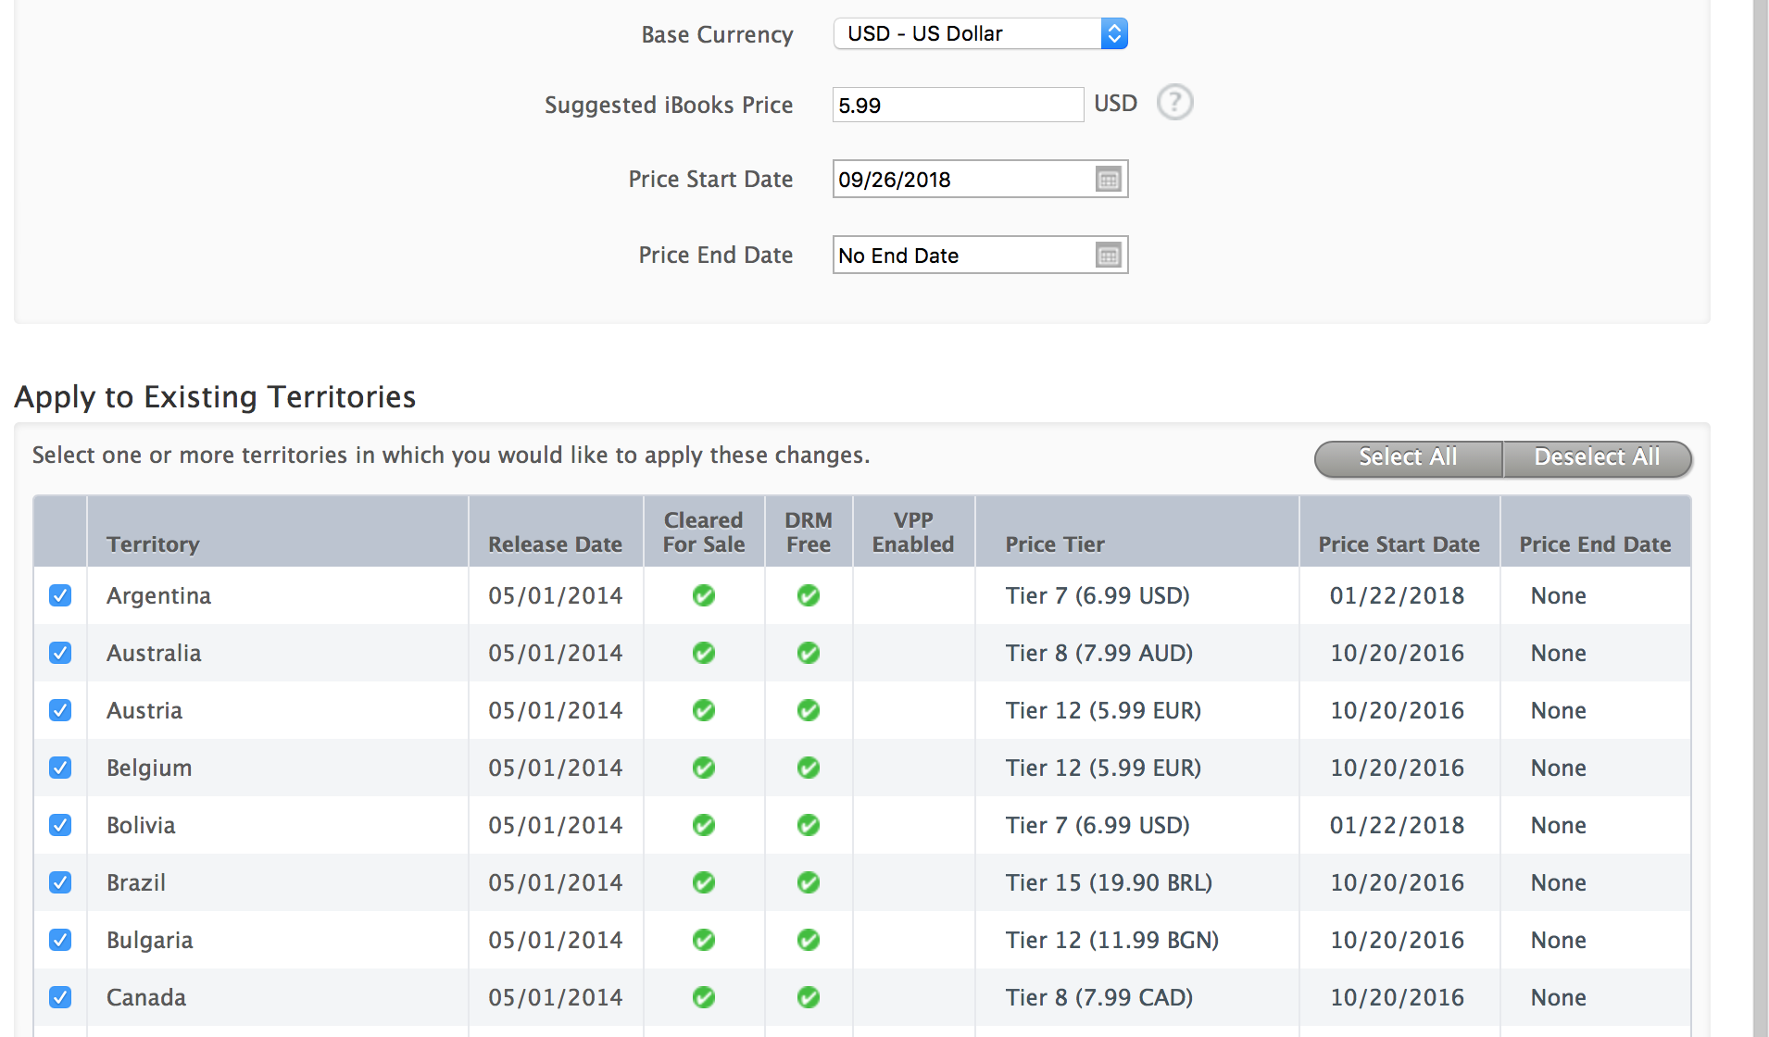
Select All or Some Territories
Notes:
Scroll to the bottom of page to submit your price change request

Slide 16
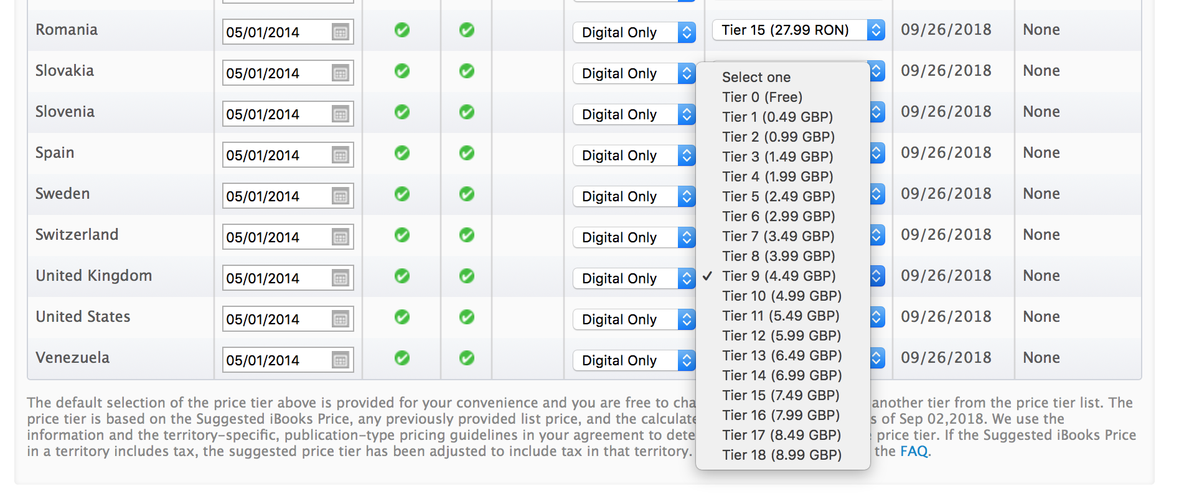
Adjust Prices as Needed
Notes:
In this example, a UK price (GBP) of £4.49 was suggested by Apple. What’s awkward is that Kobo wants prices to end in .99. So, to match prices, simply click the blue up/down arrows on the UK price, and select a different tier. You can adjust any or all of the prices before you Confirm the price change at the bottom of the page. If you’ve changed a lot of price tiers manually, when you click Confirm, be patient. It seems to take Apple longer to read all the manual changes. It may take 30-60 seconds.

Slide 17
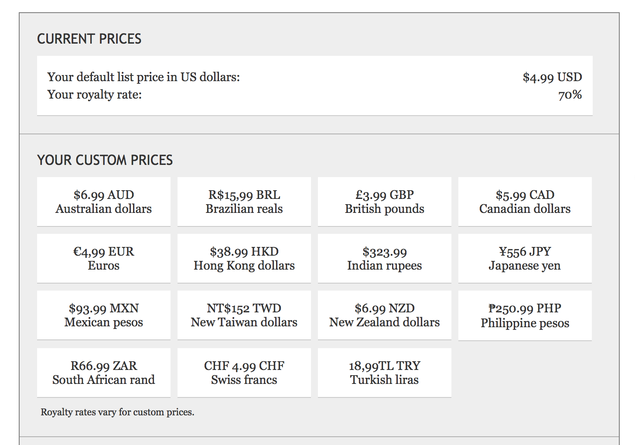
Kobo Pricing Page
Notes:
Here we’ve set a USD price, then note that all the foreign prices are listed under YOUR CUSTOM PRICES. So these are prices I’ve set, and these prices will not change due to auto-conversion updates.

Slide 18
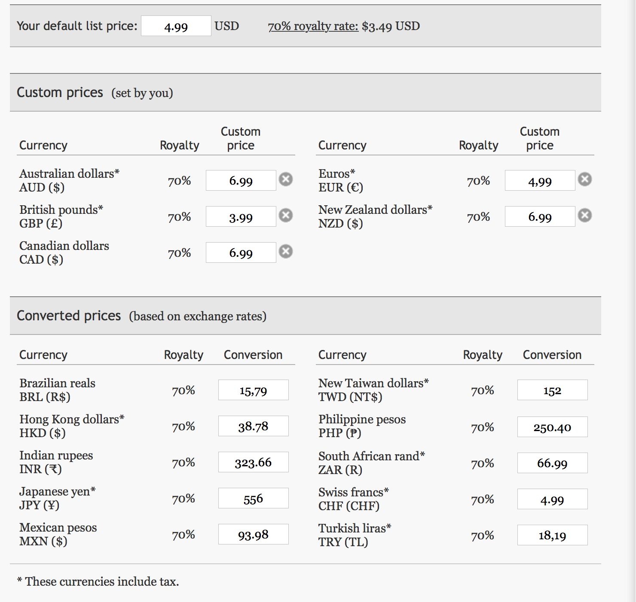
Notes:
This example shows a USD price set for $4.99, with custom prices set for the most common foreign currencies (the ones most likely to be matched across other retailers.
The lower part shows Converted Prices based on exchange rates. These prices may be updated by Kobo periodically, and note that the prices are not as customer friendly.
Note that currencies that have an asterisk include VAT tax as part of the selling price.

Slide 19
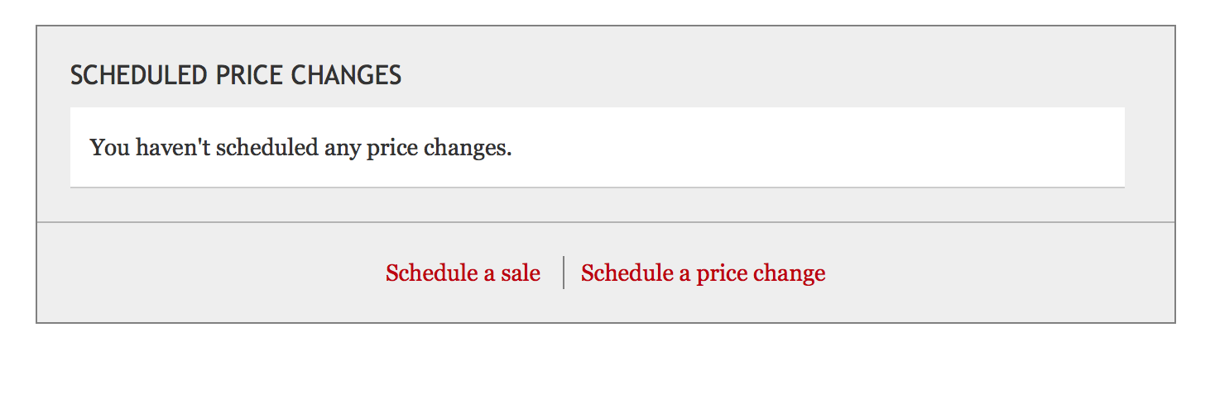
Setting Price Changes on Kobo
You can set a permanent price change to happen immediately simply by changing the active prices. Or you can pre-schedule a future price change. Often, scheduled price changes need to be set at least 24 hours in advance. It’s best to allow at least 3 days.

Slide 20
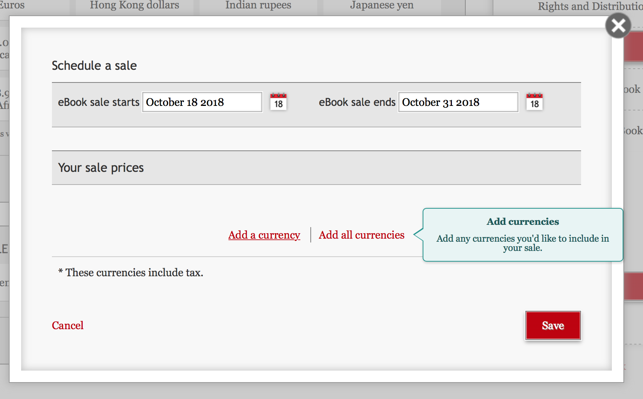
For promotions, choose your start and end date, and then you can set one or more currencies to put on sale.
Notes:
For Kobo, set the end date as if you sale price will end at the End of Day on that date. The regular price will resume the next day.

Slide 21
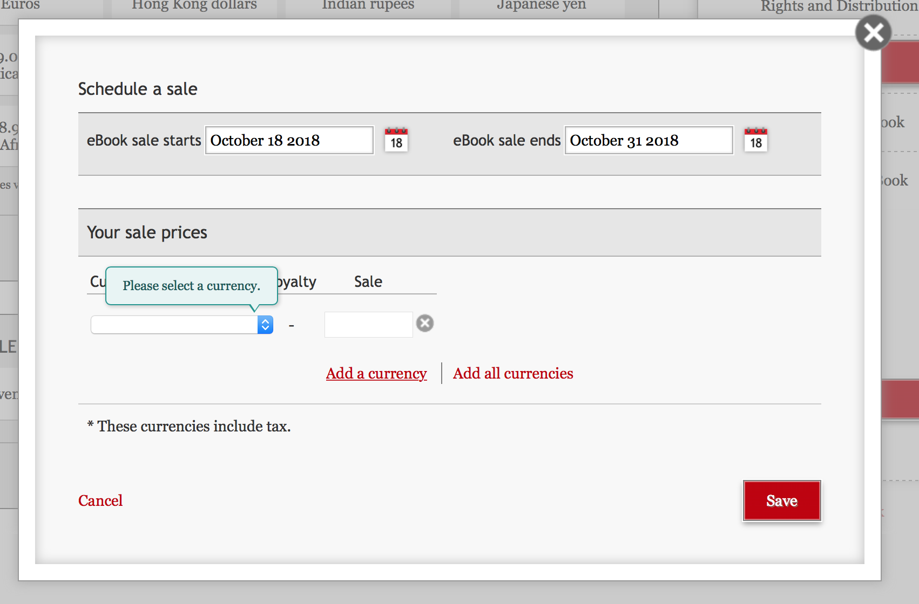
You can choose to add a few currencies one at a time (for a BookBub, you may only want to reset USD, CAD, AUD, GBP).

Slide 22
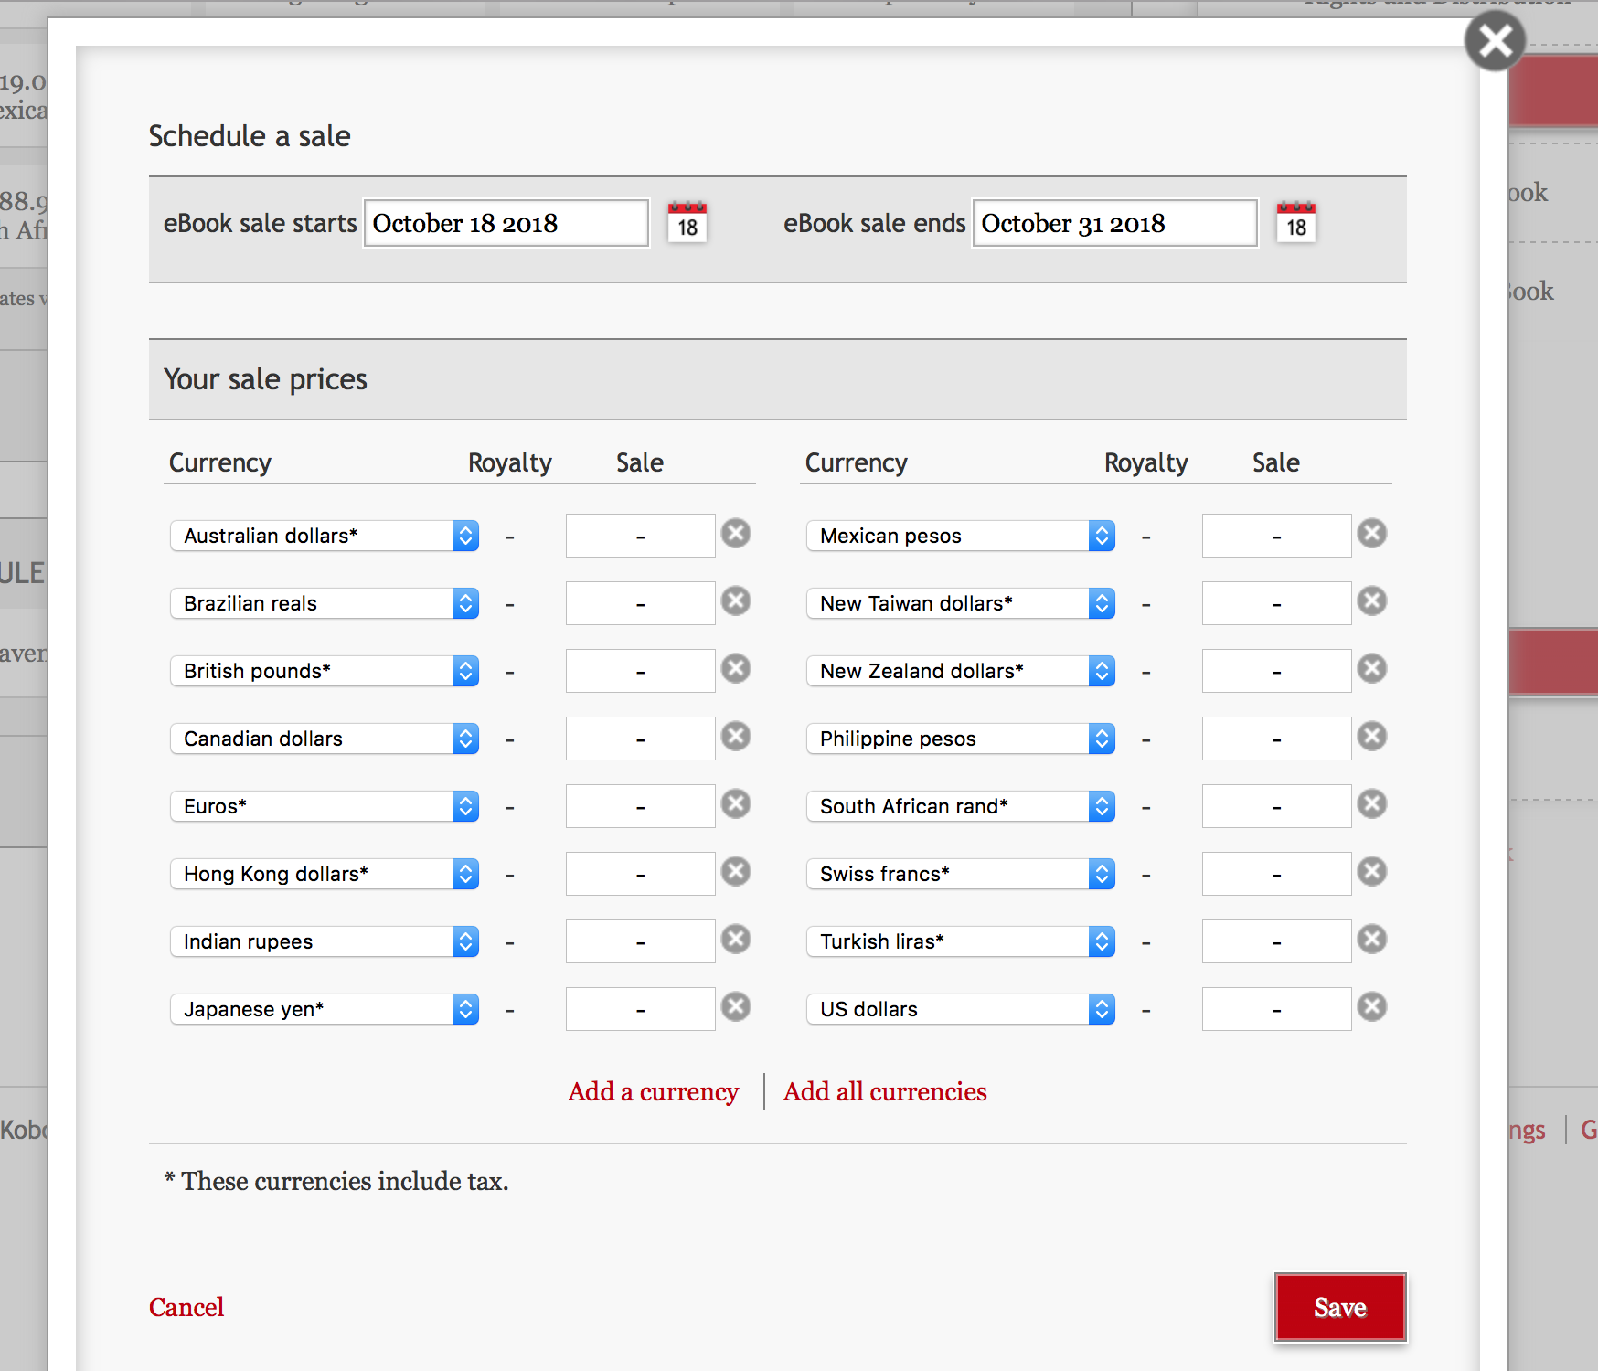
Notes:
Or add all the currencies and set the sale prices for ones you want to change. Be sure to Save.

Slide 23
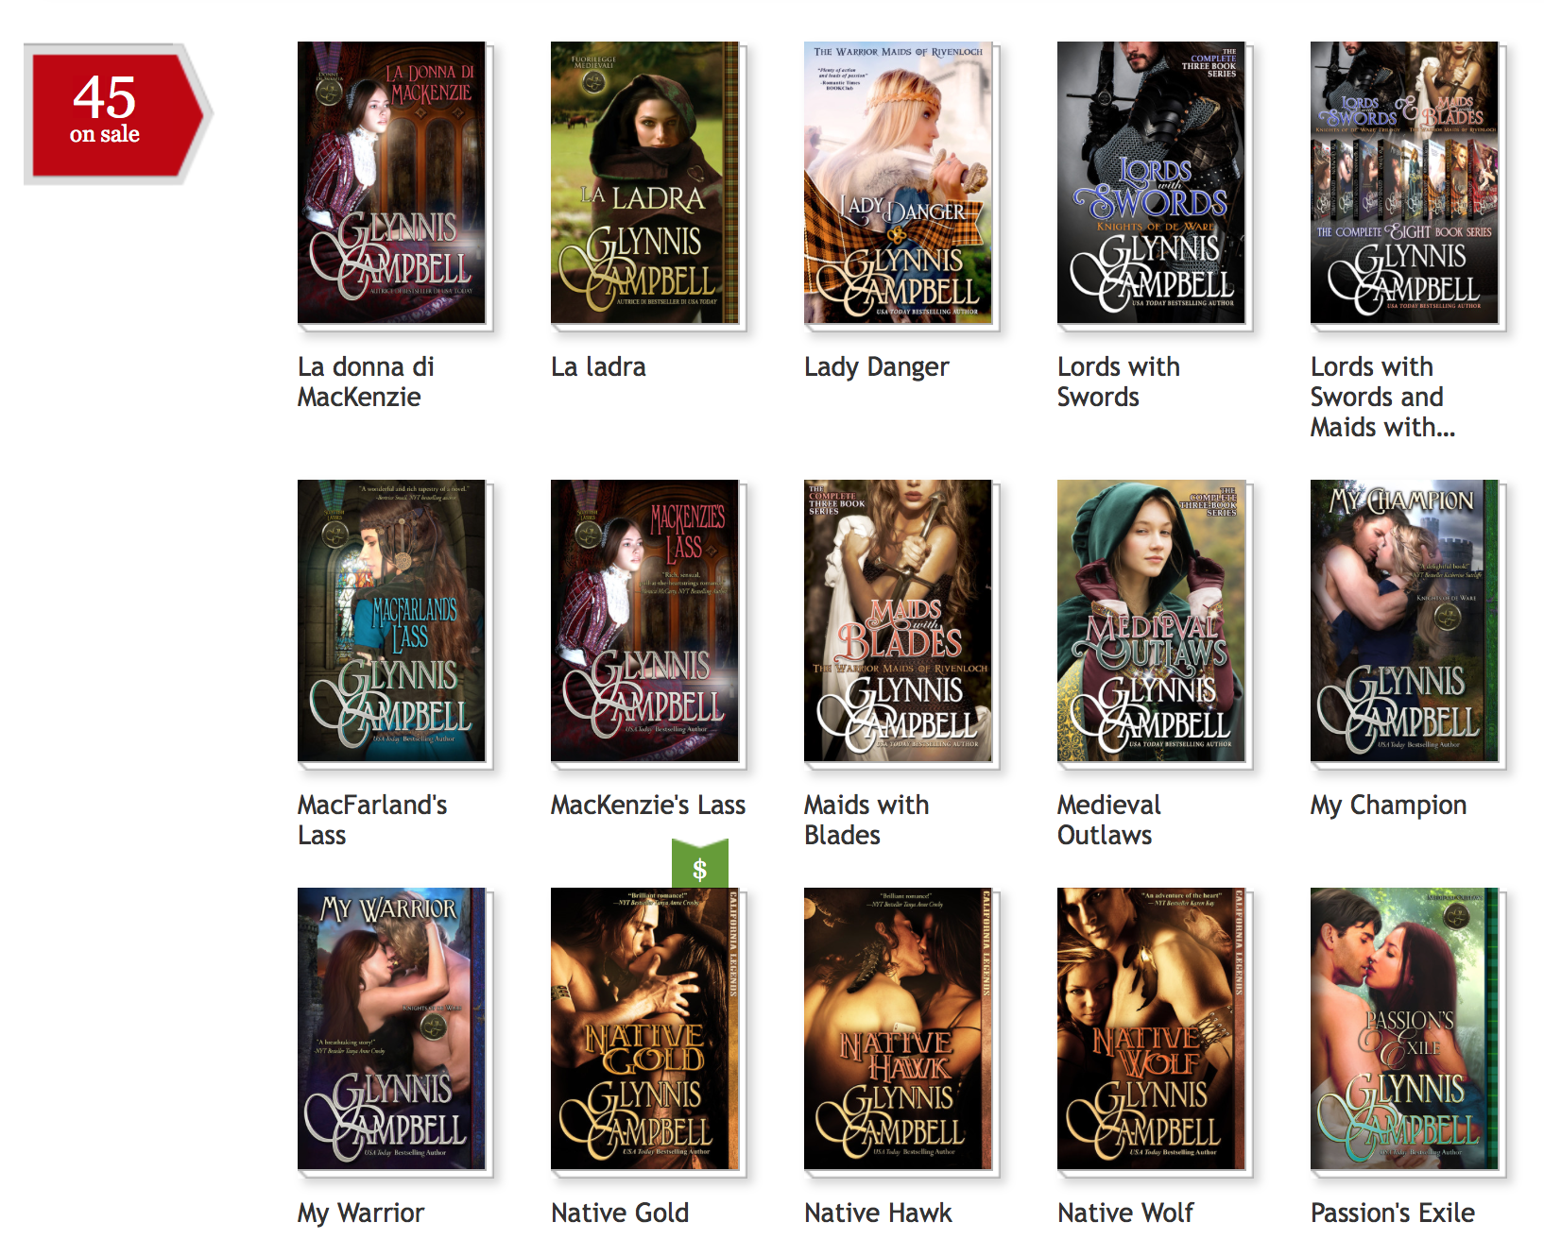
When you’ve correctly set up a promotion for a book, on your dashboard, the book will show the green price icon to alert you that you have an upcoming or current sale price programmed.

Slide 24
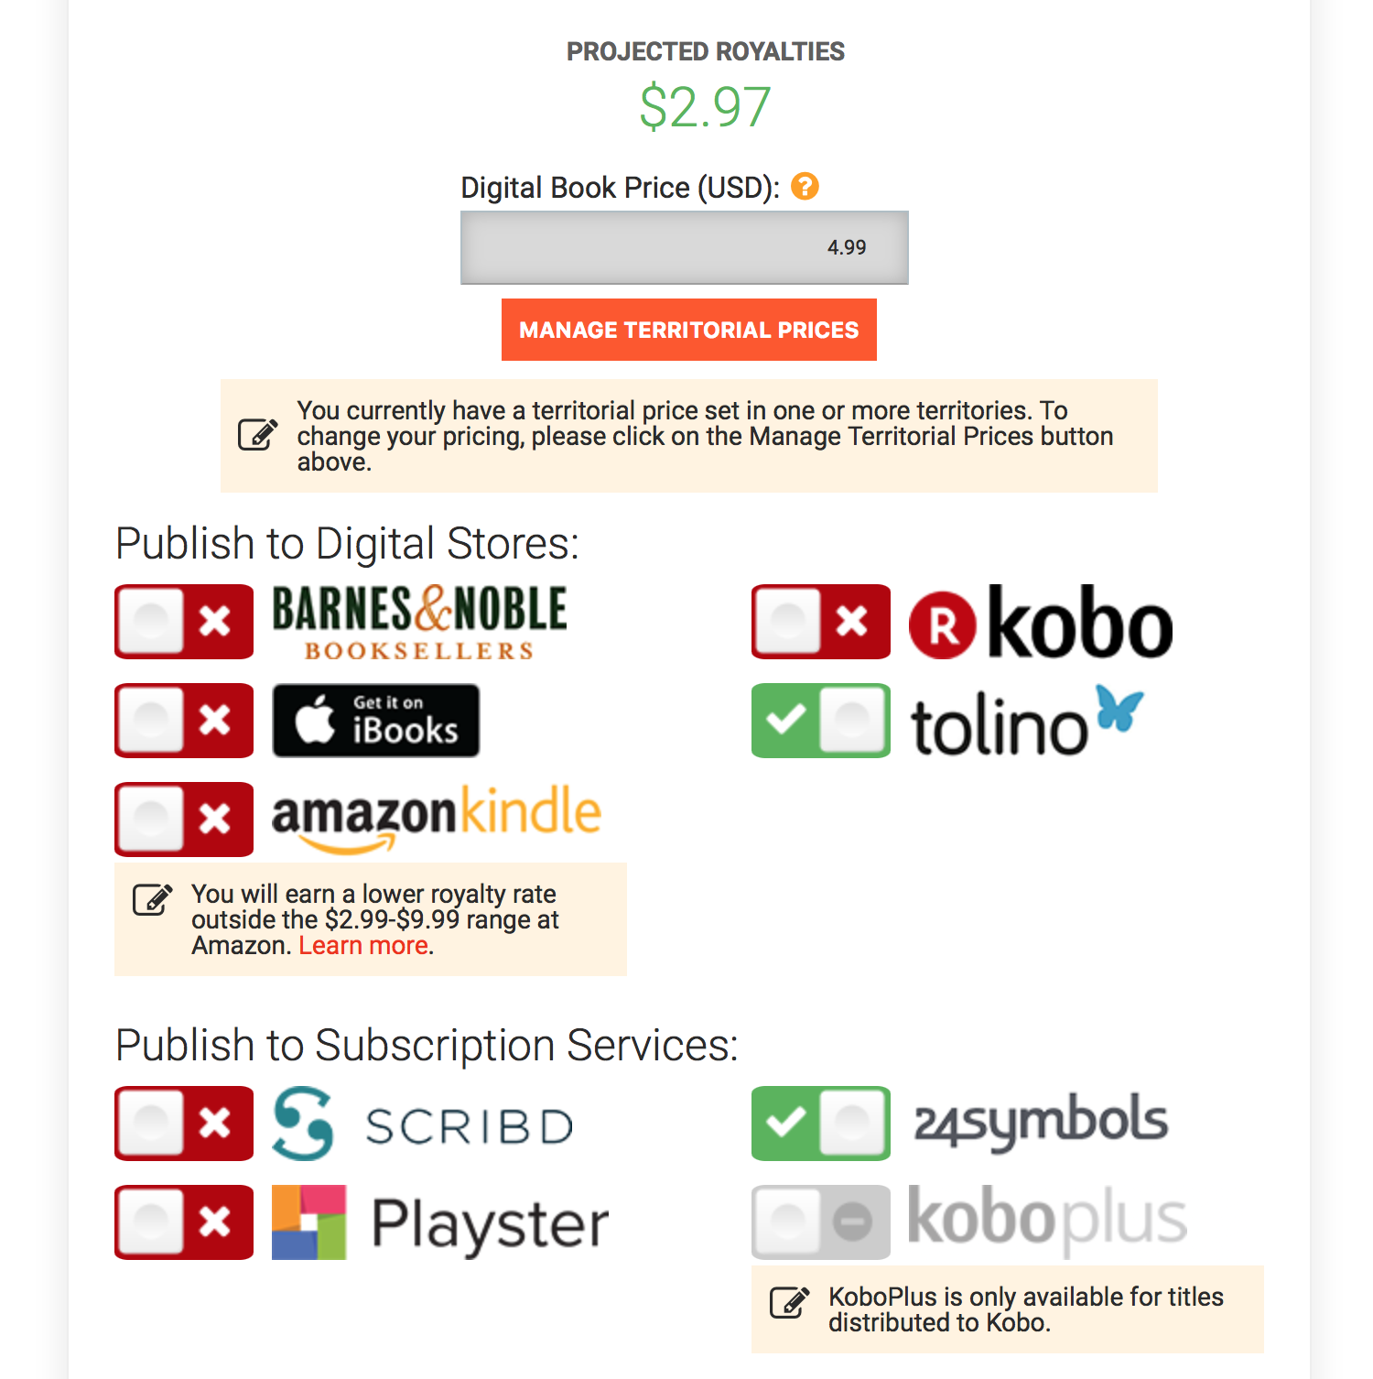
D2D
On D2D, click the orange button to manage foreign currency pricing. Be aware, if you change any of foreign currencies, you’ll get this little box and you won’t be able to edit your primary price from this screen. You must always click the orange box to access and change prices.

Slide 25
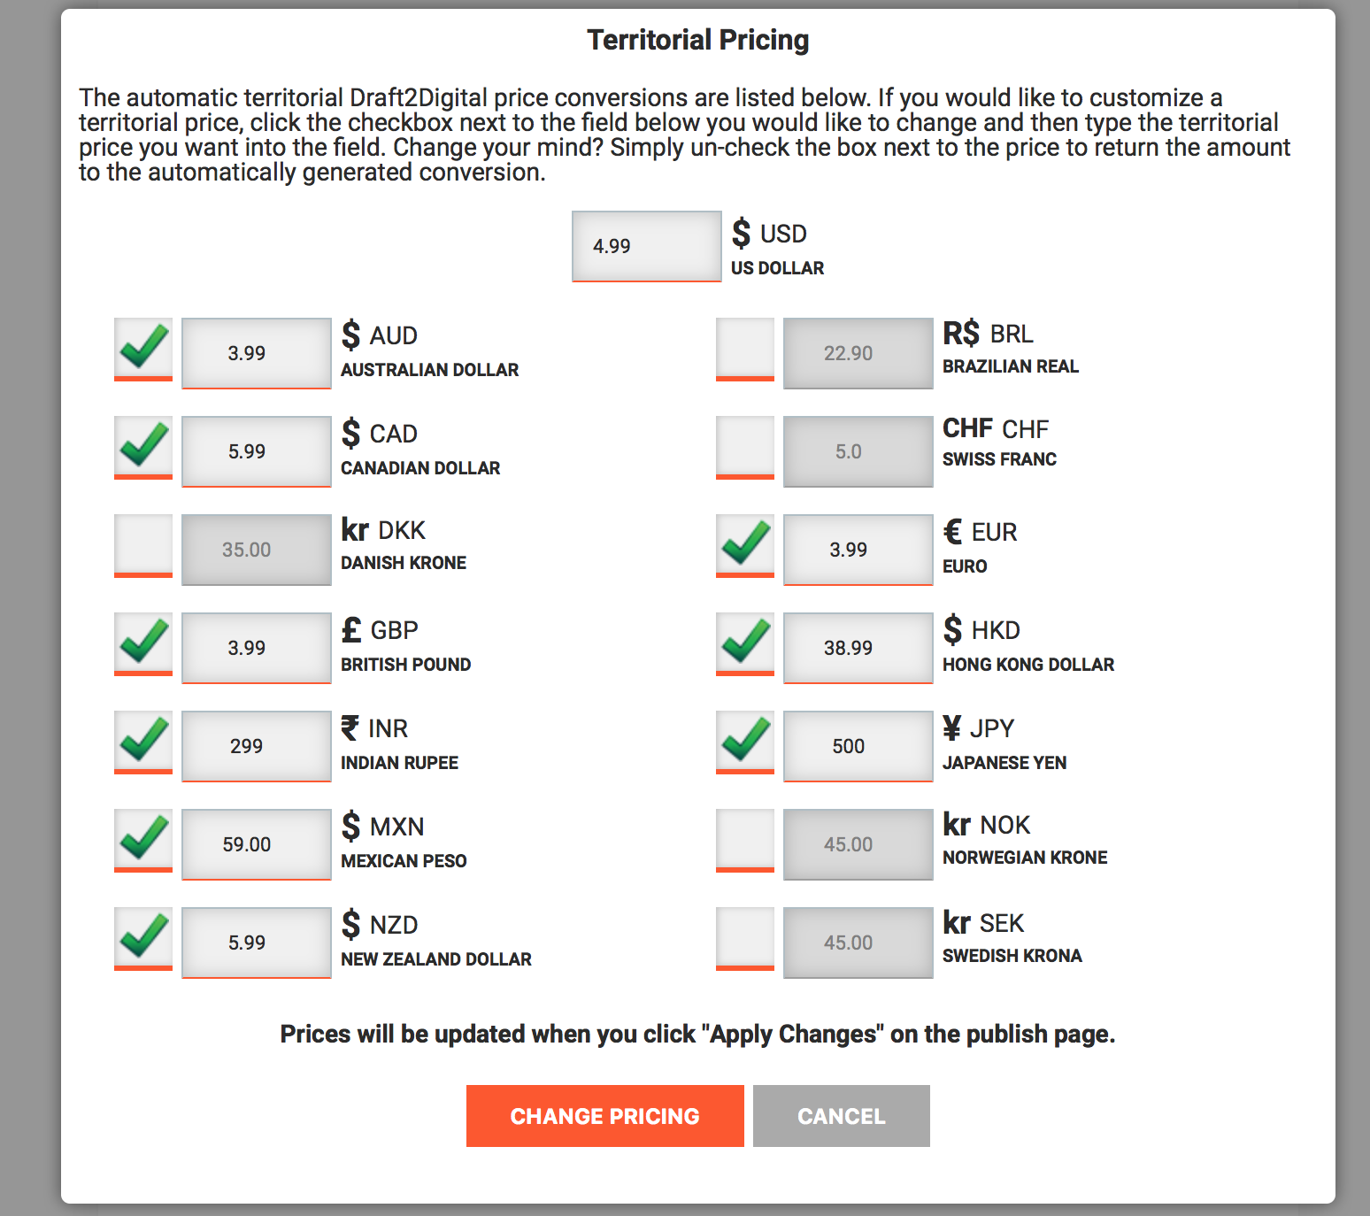
Notes:
D2D doesn’t have a lot of information on foreign pricing or conversions. From what I gather, if you only supply a USD price, then D2D supplies only the USD price to the retailers. BUT, if you supply foreign pricing, they’ll submit those prices to retailers who have those currencies on their dashboards. If you’re only distributing to B&N and Tolino via D2D, then you only would need to set a Euro price to match your other retailer Euro prices. B&N only prices in USD currently.

Slide 26
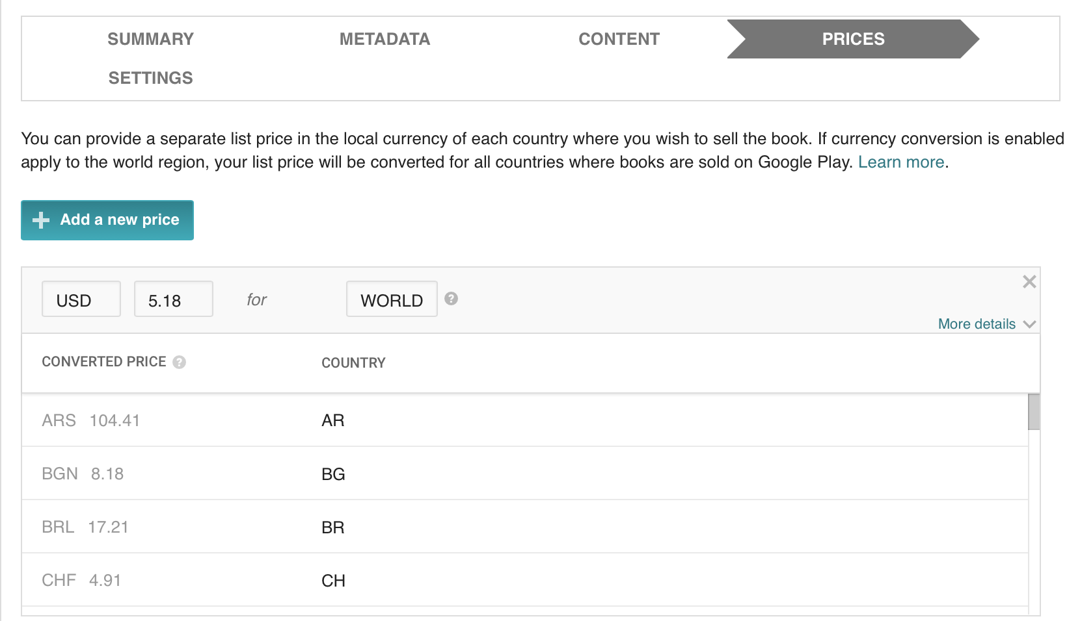
Google Play Pricing Tab
Notes:
Here is a single USD price set. You see the various foreign currency converted prices. This doesn’t happen immediately, it takes up to a day for these conversions to appear. If they do NOT appear, check your Payment Center and Summary tab to make sure things are set for converting the currencies.
NOTE: The odd-ball $5.18 price on Google Play translates to ASP of $3.99. Your royalty is based at 52% of $5.18.

Slide 27
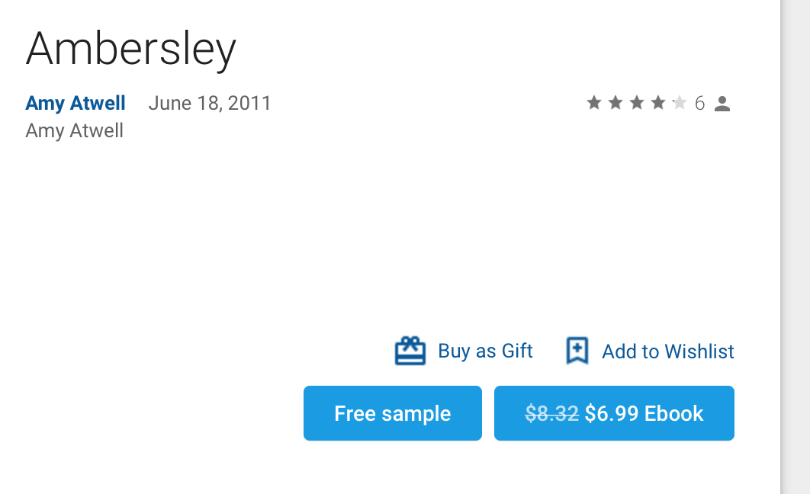
Google Play Discounted ASP
This is a picture of part of the Google Play Store selling page. The List Price for this book is $8.32 in USD, but Google Play sets the ASP at $6.99. I earn 52% royalty on the $8.32 List Price.

Slide 28
Google Play Summary Tab
Make sure you have lots and lots of territories appearing on the Summary tab. Otherwise, it’s an indication that the Currency Conversion is not turned on.

Slide 29
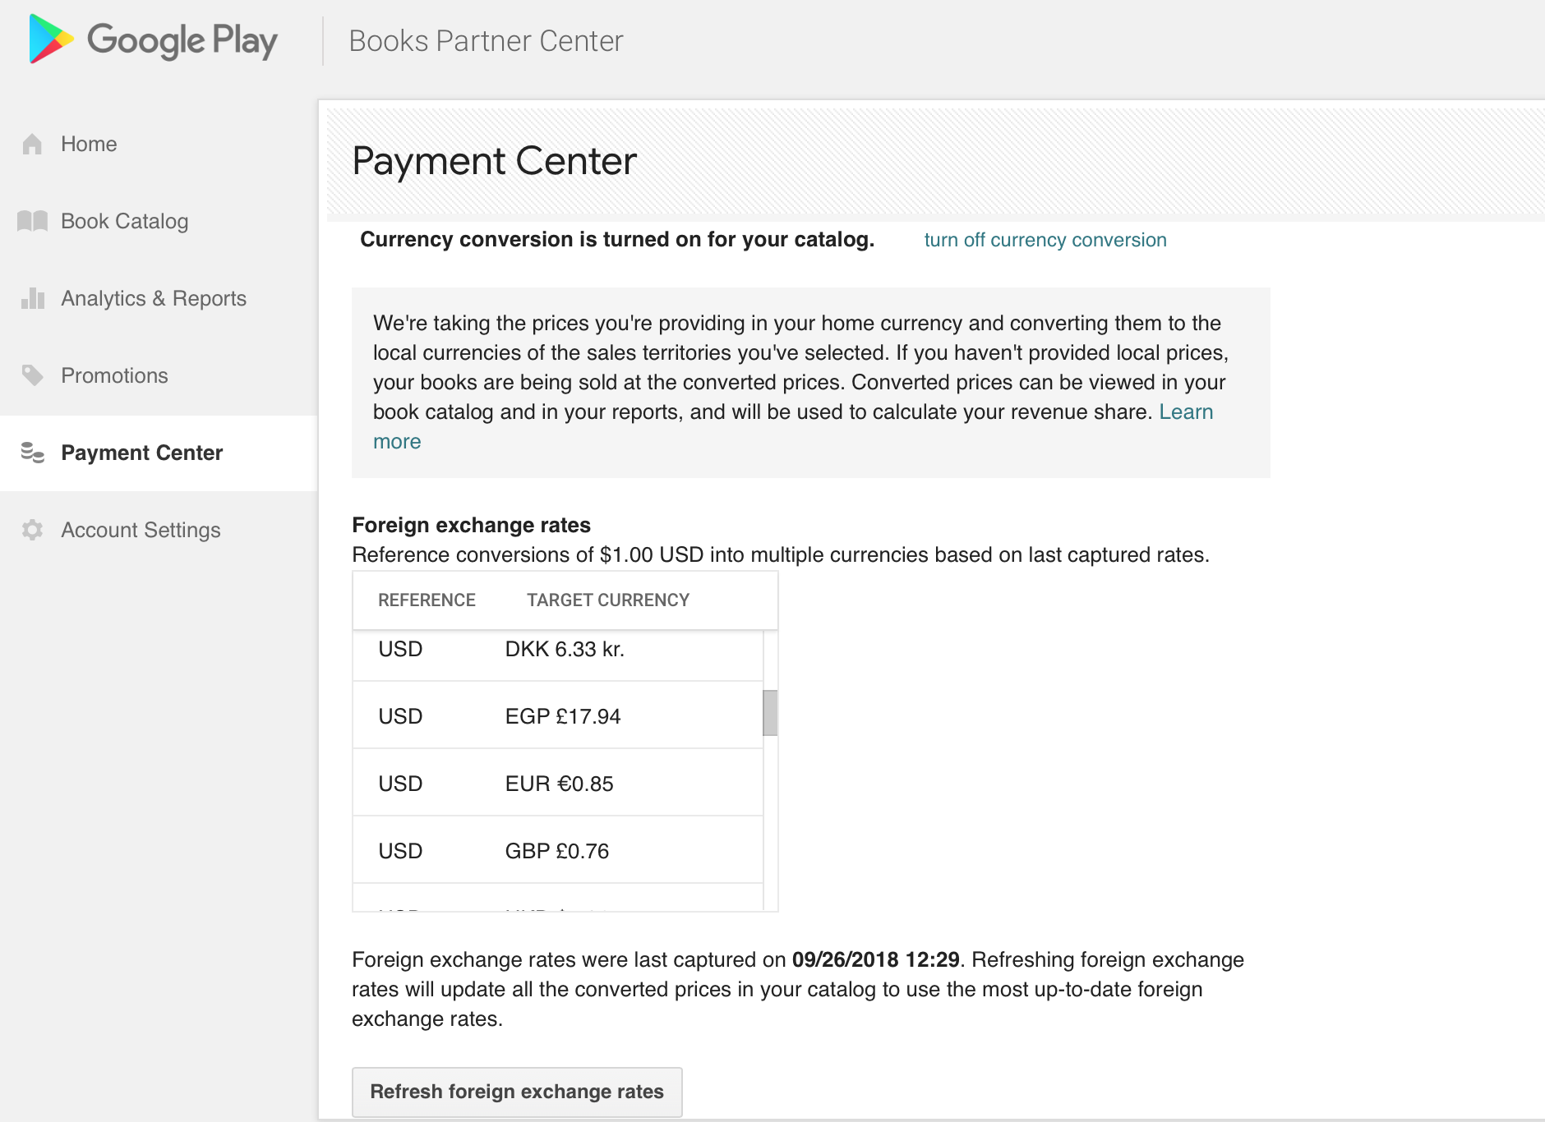
Turn On or Off Conversion
Click to refresh exchange rates
Notes:
This is the Payment Center section from left sidebar on your dashboard. Scroll to the bottom of the screen, below the Payment Profiles. Here, you can turn Currency Conversion ON or OFF. At the very bottom, it shows when the last time the exchange rates were updated. You can manually update them whenever you wish by clicking the Refresh button.

Slide 30
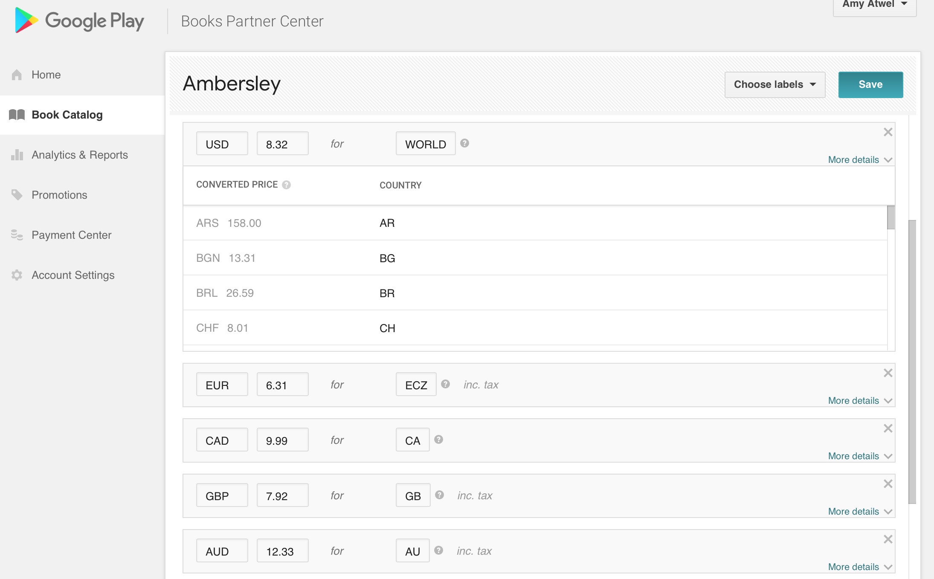
Set Foreign Pricing
Notes:
To set individual currencies, you have to set the currency, price, territory, and also whether you want Google Play to add tax or include tax in the price you’re setting. This is super important when setting up BookBub ads, because if you set a specific price, but that country adds VAT, then your ASP might not match. Also note, for 0.99 price point, GP does NOT discount that.

Slide 31
Including Tax in Price
On previous slide, you saw the More details in blue. Click those, and you get this additional information. Check the box to include tax in your price for countries that have VAT (GB, AU, IN, ECZ, NZ).
Note: on Google Play, use the territory code of ECZ to denote all countries that use the Euro as their primary currency.
Notes:
You can set temporary promotion pricing on the Pricing Tab using the date fields. You need to set the sale prices at least 24 hours in advance, and I recommend 3 days. Then be sure to check it the day the price is due to drop. I have often had to go in and delete the permanent prices or set them to have a new start date (the day AFTER the promotional end date) to get the sale price to appear. If you’re presetting a solid promotion, the Promotions Tab can work better.

Slide 32
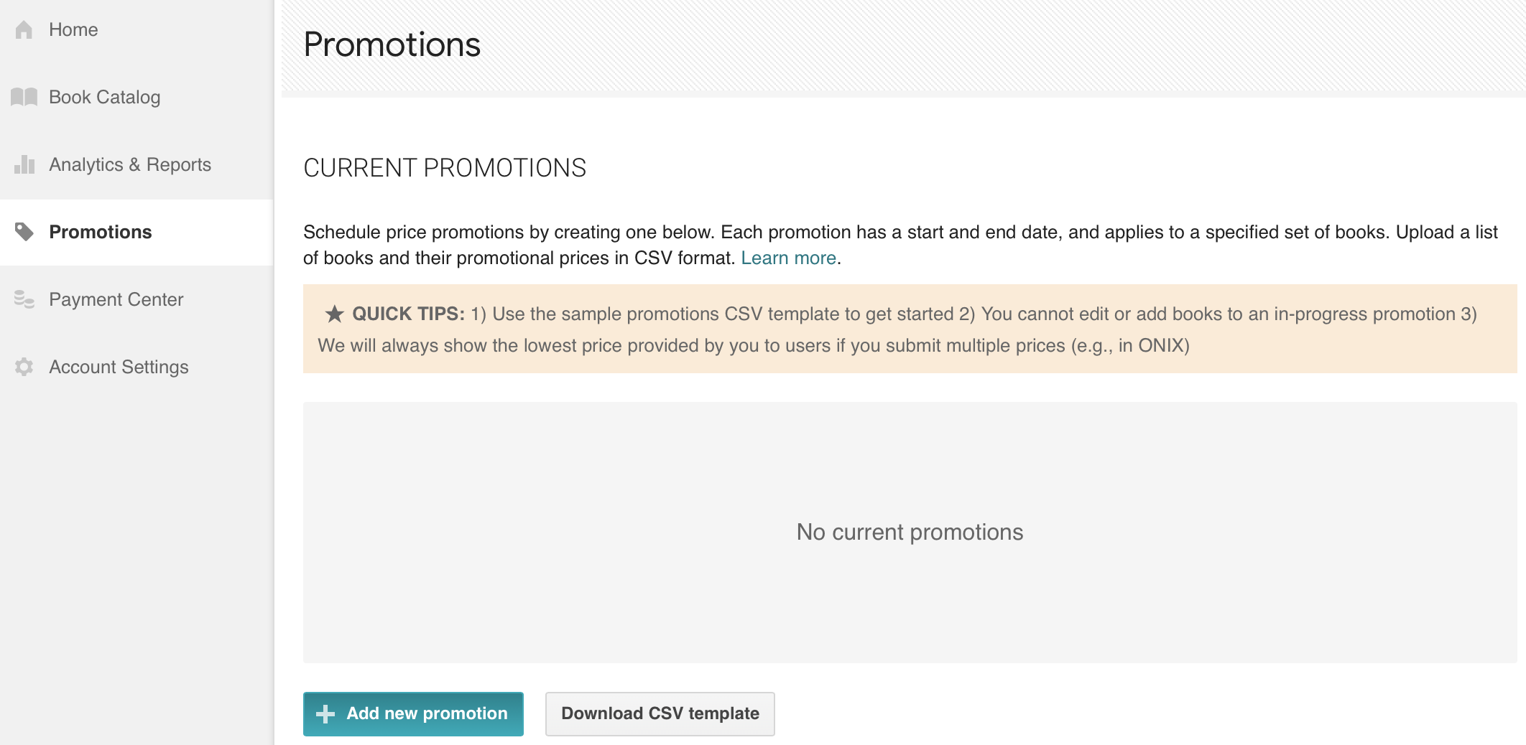
Google Play Promotions Tab
Notes:
When using the promotions tab, there are some pros and cons.
You need to set up the promo at least 3 days in advance.
You cannot edit a promotion, so once the promo starts, you’re locked into that start and end date.
You need to understand basics of Excel to work with the CSV template form to submit your promo.

Slide 33
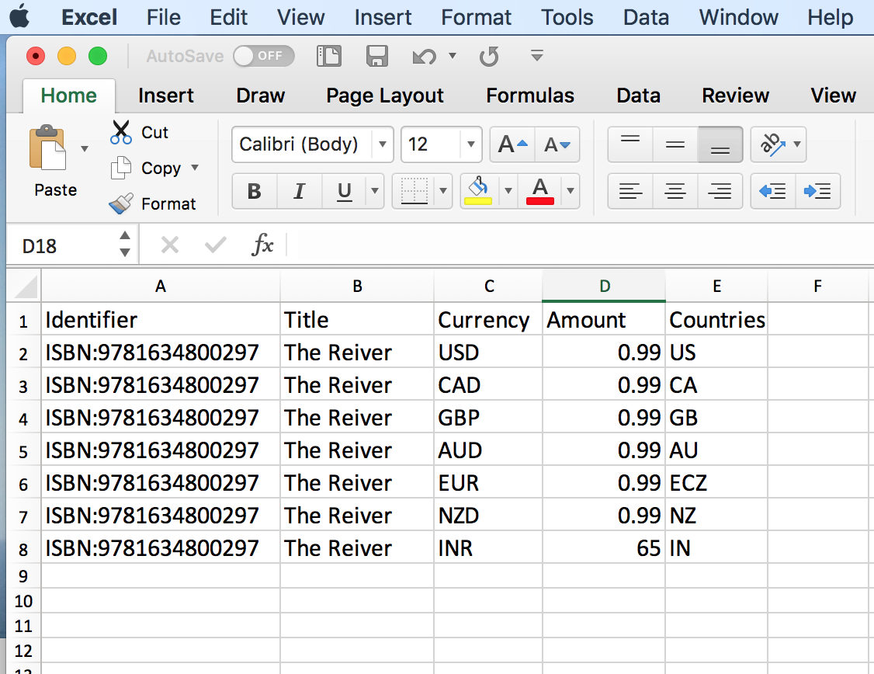
Google Play Promotions CSV Example
Download a CSV template. It opens in Excel. The only fields that will be filled in will be Row 1, showing what information they want in each column. Add the book(s) you want to promote with ASP pricing. The prices on this form will not be discounted.
Notes:
Google Play does not discount these promo prices. Use the ASP you want customers to see in each currency/territory.
Google Play pulls the data on VAT inclusion in the price from the Pricing Tab, so for any currency you want to put on promo, you need to have a regular price set for that currency with the tax setting in place on the Pricing Tab.

Slide 34
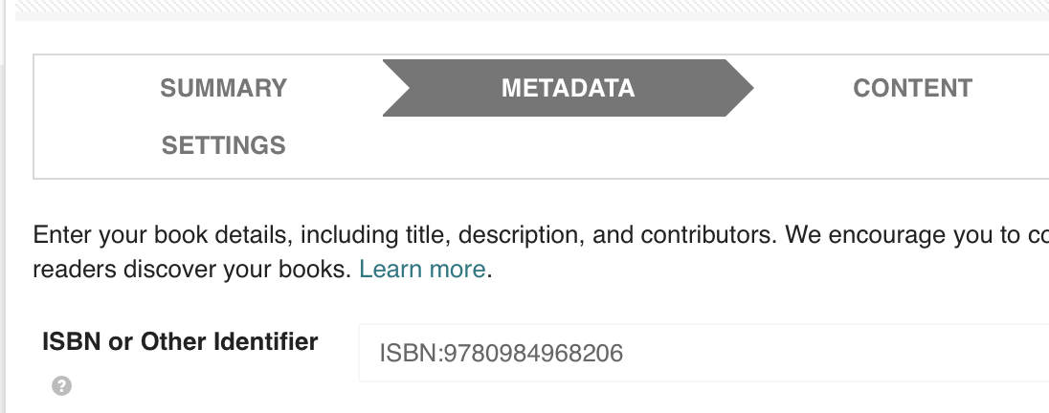
On the CSV form, they ask for the book identifier. You can copy it from the Metadata tab, the ISBN or Other Identifier field. It will either start with ISBN: or GGKEY: Be sure to include the letters that start the identifier, not just the digits.

Slide 35
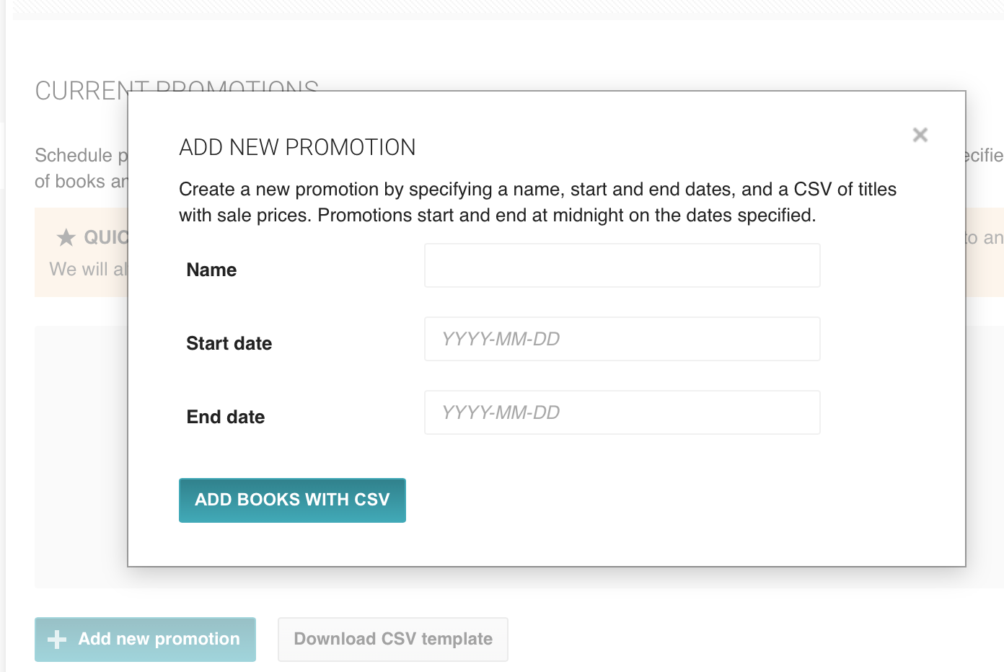
Click the + Add new promotion button, and fill in the fields on the popup. Your end date will end the promotional pricing at 11:59 p.m. on that date. Then click the Add Books with CSV button, and Google Play will let you browse for your CSV file and upload it.

Slide 36
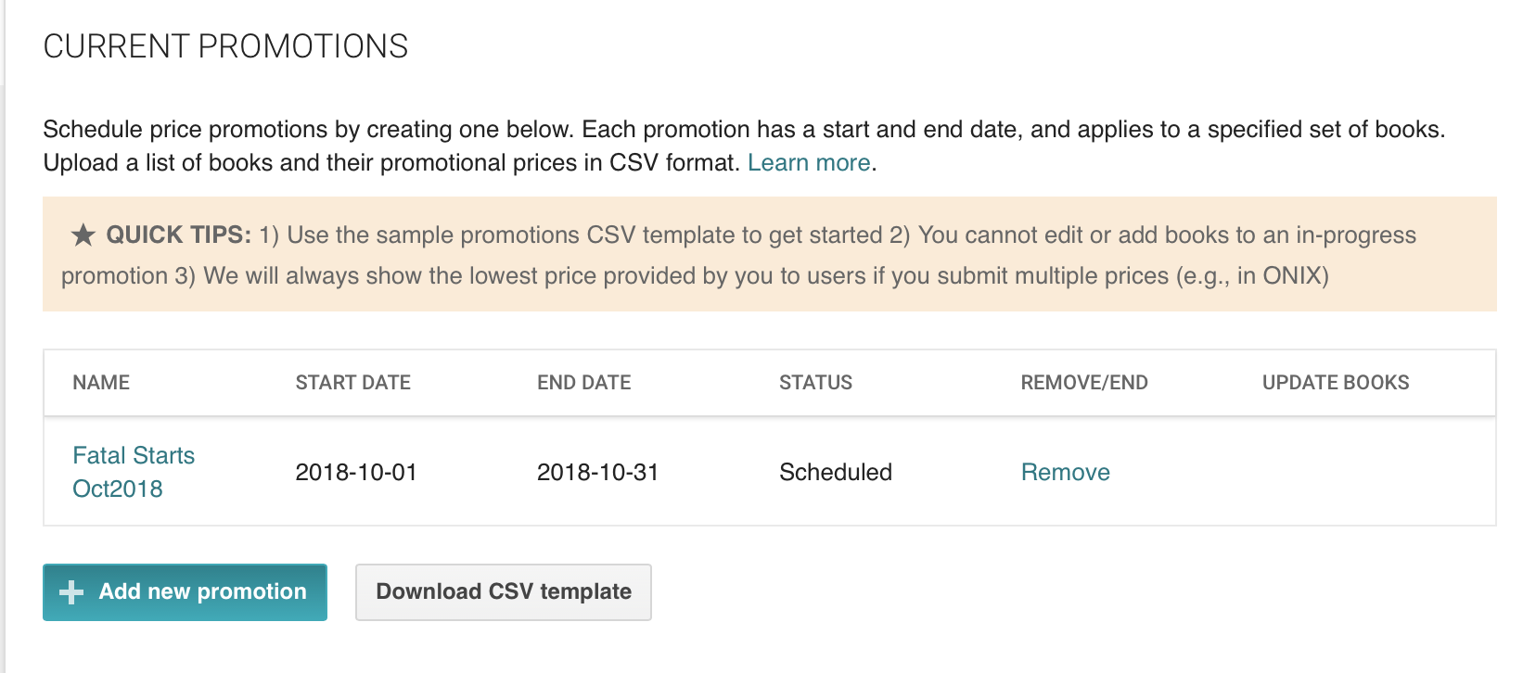
Once your promotion is accepted, it will show as Scheduled. If there are errors in your CSV file, Google Play will alert you.

Slide 37
Tips for Setting BookBub Pricing
You can set Apple, Kobo, B&N and Google Play in advance. KDP and D2D need to be set the day you want the price to change.
If you’re setting a free price, be sure to set it well in advance so you can request KDP match it. (a week or more before the promo starts)
Bear in mind that Australia is more than 12 hours ahead of US Eastern Time Zone time, so your price in Australia needs to be in place earlier.
When setting Google Play pricing, be sure your prices for GBP, AUD, INR all include tax.

Slide 38
Questions?
http://www.authorems.com/author-services/downloads/
amy.atwell@authorems.com
Notes:
Bonus: on the Downloads page, you can download the presentation in Keynote, Power Point or PDF. I’ll also include my Presenter Notes as part of the files (whatever formats use them).
If you email me a request, I will email you my Google Play pricing list. Most of you probably have the USD version that shows List Prices and what the ASP will be. I have similar lists for GBP, EUR, CAD, AUD, NZD. And, by popular demand, I will make a sample grid showing suggested converted prices in the major currencies.

Slide 39
Plan Your Attack:
Make a list of your most common USD prices
Open all your dashboards and choose one book and go to the pricing page for each retailer.
Compare foreign currency conversions and price tiers.
Make a price grid for yourself.
Decide on what makes a logical foreign currency conversion for the most common currencies, then use those foreign prices all the time.
Notes:
Decide what makes a good comparative price in GBP, CAD, EUR, AUS at a minimum, since these are the currencies used on most dashboards.
On your grid, set logical prices based on your USD price. Then use those prices every time. $4.99 always equals £3.99 and €4.99 and $5.99 CAD, and $6.99 AUD or whatever. Do the same for all your common price points.

